Slide 1
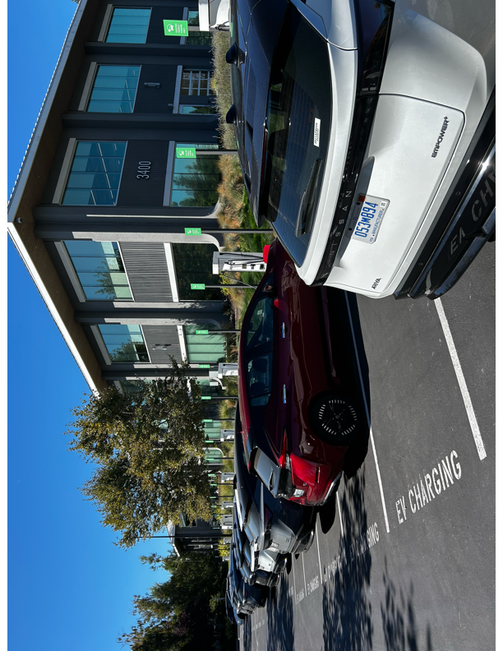
Reinforcement Learning-based Approach for Vehicle-to-Building Charging with Heterogeneous Agents and Long-Term Rewards
Vanderbilt University
Fangqi Liu
Rishav Sen
Jose Paolo Talusan
Ayan Mukhopadhyay
Abhishek Dubey
Nissan Advanced Technology Center
Ava Pettet
Aaron Kandel
Yoshinori Suzue
Notes:
Put something about AAMAS in the s
Hello, and thank you for watching. This presentation introduces our AAMAS paper on applying reinforcement learning to vehicle-to-building charging optimization, a collaboration between Vanderbilt and Nissan teams.

Slide 2
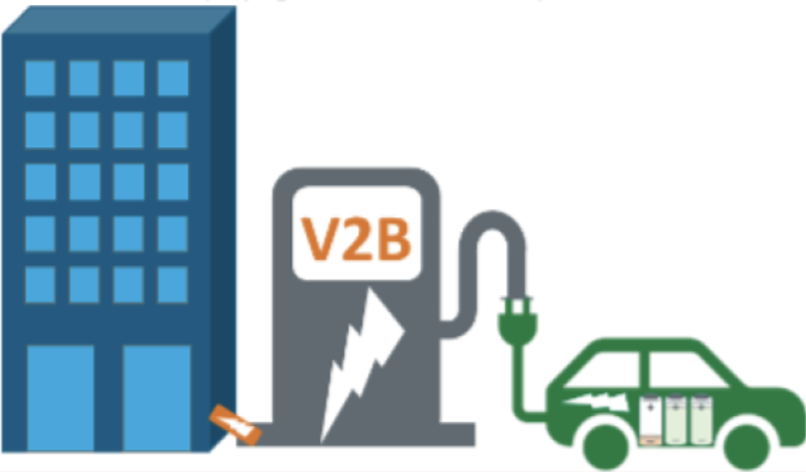
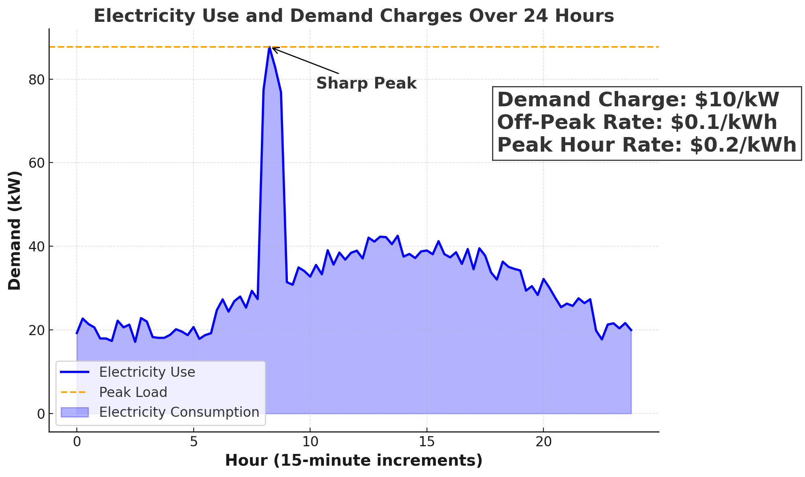




Vehicle-to-Building (V2B) Problem
V2B integrates electric vehicles (EVs) into building’s energy systems
Social Impacts:
Energy Resilience & Environmental Benefits: EVs serve as power storage units and helping stabilize power consumption from the grid.
Energy Sources
From Grid
Demand Charge:
Additional fees on C&I electricity bills based on the highest power drawn (kW) during the billing period.
From EV
Economic Savings: EVs lower electricity bills by reducing demand charges during peak times.
Our Focus
Image Source: US Department of Energy
Notes:
Vehicle-to-Building, or V2B, platforms connect electric vehicles to building energy systems. This integration allows EVs to act as mobile backup power storage during outages. At the same time, V2B helps stabilize the grid during peak demand.
Another key social impact of V2B is its ability to save on electricity bills. By discharging EVs, V2B helps flatten power usage over the billing period, reducing demand charges based on peak power consumption. Achieving this is the main goal of our work.
Another key social impact is that by discharging EVs during peak hours, we can reduce demand charges, which IS A big part of the electricity bills for commercial and industrial buildings. Demand charges are proportional to the peak power consumption over long-term billing periods, such as one month or even a year. This is the focus of our work.
————————————————————
Vehicle-to-Building (V2B) platforms connect EVs to building energy systems, enabling them to act as mobile power storage, enhancing energy resilience and stabilizing the grid power consumtion.
V2B also reduces electricity bills by flattening power usage and lowering demand charges based on peak power consumption. Achieving this is the main goal of our work.
Traditional energy distribution is centralized
But with the addition of distributed energy resources transferring energy back to the main grid became is an option.
This also provides the opportunity for transferring energy directly between agents.
Energy Resilience: EVs act as backup power sources during outages, as seen during Hurricane Helene, where EVs powered essential appliances in Charlotte, NC.
• Economic Savings: EVs reduce demand charges by discharging energy during peak times, lowering electricity bills and improving energy efficiency.
• Environmental Benefits: V2B systems stabilize the grid during peak demand, reducing reliance on fossil fuels and lowering greenhouse gas emissions.

Slide 3
Vehicle-to-Building (V2B) Problem: Goals
From Grid
Building
Power
From EV
0
Req. SoC
Stay duration
Cur. SoC
EV Charging
Rate
Car stay duration
Bi-directional
Required State of Charge (SoC):
The battery level of an EV (%)
Stay duration:
current time and departure time.
0
Uni-directional
Our Focus
V2B Charging Objective: Sequentially determine charging or discharging rates for EVs
2
Notes:
Let’s get into the details of our scenario. The building gets power from the grid, and its energy usage is recorded over time. It has a mix of bidirectional chargers, which can charge and discharge EVs, and unidirectional chargers, which only allow charging.When an EV arrives, it’s assigned to a charger and tells the system two things: its required state of charge or SoC, which is the battery level it needs before its departure, and its departure time.
Our goal is to optimize the charging and discharging rates for all EVs during their stay duration, in a way that minimizes the total electricity bill. The bill has two parts: energy cost for energy consumption for the building and EVs, and demand charges, which depend on the peak power draw in peak hours during the billing period. At the same time, we need to make sure all EV charging needs are met.
-------------------------
Let’s dive into the details of our scenario. The building is powered by the grid, . It has a mix of bidirectional chargers, which can charge and discharge EVs, and unidirectional chargers, which only allow charging.
When an EV arrives, it’s assigned to a charger and provides two key details: its required state of charge (SoC) before departure and its departure time.
Our goal is to optimize charging and discharging rates for all EVs during their stay, minimizing the total electricity bill, which includes energy costs and demand charges based on peak power during peak hours, while ensuring all EV charging requirements are met.
---------------------------
Traditional energy distribution is centralized
But with the addition of distributed energy resources transferring energy back to the main grid became is an option.
This also provides the opportunity for transferring energy directly between agents.

Slide 4
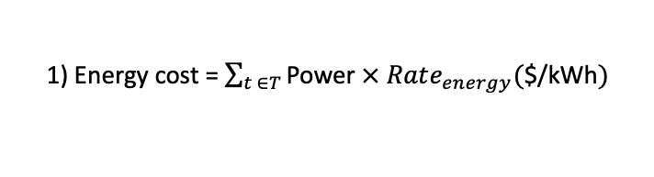

Vehicle-to-Building (V2B) Problem: Goals
Off-Peak Rate: $0.1/kWh
Peak Hour Rate: $0.2/kWh
Demand Charge: $10/KW
Off-peak
Peak hour
Off-peak
Peak Building Load
Off-peak
Peak hour
Off-peak
Peak Building Load
Building
Power
Optimized Peak Power
Total Power
(Building
+Chargers)
0
$$+$$
0
EV stay duration
Charging
Rate
Charging
Rate
1) Energy cost = $\sum_{t ∈T}{\text{Power}}$ $×$ $Rate_{energy}($$/kWh$)$
0
2) Demand charge = Peak Power draw $×$ $Rate_{demand}($$/kW$)$
V2B Charging Objective: Sequentially determine charging or discharging rates for EVs
  Minimize total electricity bill, including energy cost and demand charge.
  Operate under uncertainty in EV arrivals, departures, and SoC needs.
  Ensure EV charging requirements are met.
3
Notes:
in a way that minimizes the total electricity bill. The bill has two parts: energy cost for energy consumption for the building and EVs, and demand charges, which depend on the peak power draw in peak hours during the billing period. At the same time, we need to make sure all EV charging needs are met.
--------------------
Addressing this problem presents several challenges. Real-time decision-making is required in an uncertain environment with varying EV arrivals, charging needs, and building loads over time, making offline optimization and simple heuristics ineffective.
Additionally, decisions must be made in a continuous action space while optimizing long-term rewards, such as minimizing monthly demand charges. Traditional RL methods, designed for simpler environments with discrete actions, struggle with these complexities and face the curse of dimensionality at scale.
-----------------------
Traditional energy distribution is centralized
But with the addition of distributed energy resources transferring energy back to the main grid became is an option.
This also provides the opportunity for transferring energy directly between agents.

Slide 5
Vehicle-to-Building (V2B) Problem: Challenges & Limitations
Real-time decision-making
Uncertain EV arrival/departure and charging requirements, and building load
Online scheduling & heuristic approaches. [Lee2021]: None discharging or SoC req.
Heterogeneous multiple (15) chargers and continuous action spaces
Most existing RL approaches for V2B problem solve simpler environments, discrete action space, and short-term rewards.
[Mocanu2019]: Single day, Boolean decision
[Zhang2022]: 3 Chargers, none demand charge
Optimizing long-term rewards, e.g., monthly demand charge
[Lee2021] Z. J. Lee et al., “Adaptive Charging Networks,” IEEE TSG, 2021.
[Mocanu2019] E. Mocanu et al., “Deep RL for Building Energy Optimization,” IEEE TSG, 2019.
[Zhang2022] Z. Zhang et al., “Federated RL for EV Charging,” IEEE Globecom, 2022.
4
Notes:
To solve this problem, we face several challenges. First, the system requires real-time decision-making in an environment full of uncertainties, such as EV arrivals, departures, charging requirements, and fluctuating building loads, which can vary significantly across different times and seasons. These uncertainties make offline linear optimization or simple scheduling heuristics ineffective, as they fail to account for future events.
Another challenge is the presence of heterogeneous charger types, requiring decisions for multiple chargers in a continuous action space. Additionally, we aim to optimize for long-term rewards, such as minimizing the one-month demand charge. Traditional reinforcement learning solutions struggle with this complexity, as they are typically designed for simpler environments with discrete action spaces, and often face the curse of dimensionality when scaling to larger, more complex problems
-----------------
Our contributions include modeling this complex problem as a Markov Decision Process for long-term optimization. We enhance the MDP by integrating long term feature estimates into the state representation and reward function design.
We also propose a novel reinforcement learning approach by incorporating policy guidance and action masking, which significantly improve RL training performance. Finally, we validate our proposed methods using real-world data provided by Nissan.
-----------------

Slide 6
Vehicle-to-Building (V2B) Problem: Contributions
Our Contributions:
Real-time decision-making
We model the problem as a Markov Decision Process (MDP).
Uncertain EV arrival/departure and charging requirements, and building load
Integrating long-term feature estimation into MDP design to address delayed and sparse rewards.
Heterogeneous multiple (15) chargers and continuous action spaces
Novel techniques:
  Integrating RL training with policy guidance from a Mixed-Integer Linear Programing (MILP);
  Incorporating action masking that leverage domain knowledge and problem structure.
Optimizing long-term rewards, e.g., minimizing monthly peak power
Evaluation of the proposed approaches using real-world data from Nissan.
5
Notes:
Our contributions include modeling this complex problem as a Markov Decision Process for long-term optimization. We enhance the MDP by integrating long term feature estimates into the state representation and reward function design
We also propose a novel reinforcement learning approach that improves training performance through policy guidance that integrating optial actions from mixed intergrat lienar progamming solution, and action masking based ono domain-specific heuristic , which significantly improve model performance.
finally, we validate our approach using real-world data from Nissan, demonstrating its effectiveness.
-------------------
Next, go to our MDP definition. The action in our MDP represents the charging rates of all chargers at each time slot.
We carefully design the state features to capture essential information, including the current time slot, the building’s current and historical load data and EV arrival numbers. We also incorporate the estimated peak power draw for the billing period, learned from historical data, which is critical for minimizing long-term demand charges.
The state also tracks the status of each charger at the current time, including the SoC and remaining stay duration for each connected EV.
---------------------------

Slide 7
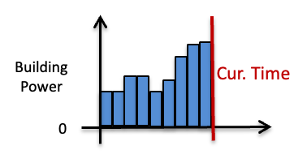
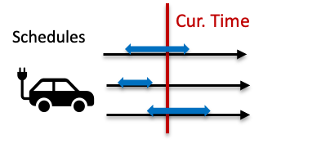

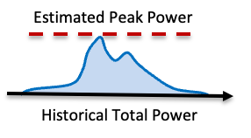
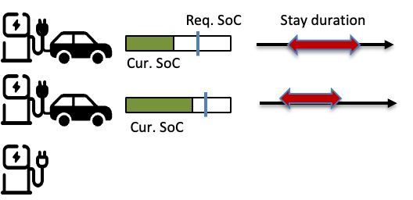
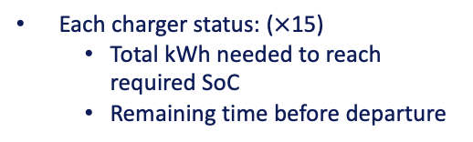
Model: Markov Decision Process
MDP:
Action A at each time slot: Charging rates for all chargers (float values)
State S at each time slot (37 features)
Current time slot
Day of week
Current Building Load
Mean of historical building Load
Variance of historical building load
EV arrival numbers by now
Estimated Peak Power
Each charger status: ($×$15)
  Total kWh needed to reach required SoC
  Remaining time before departure
6
Notes:
Predicted peak power provided by the ILP solution
What does the highlight part mean?
Next, go to our MDP defintnion. , where the action represents the charging rates of all chargers at each time slot.
The action in our MDP represents the charging rates of all chargers at each time slot.
We carefully design the state features to capture essential information,
including the current time slot, the building’s current and historical load data and EV arrival numbers.
We also incorporate the estimated peak power draw for the billing period,
learned from historical data, which is critical for minimizing long-term demand charges.
The state also tracks the status of each charger at the current time, including the SoC and remaining stay duration for each connected EV.
----------------
Next, go to our MDP definition. The action in our MDP represents the charging rates of all chargers at each time slot.
We carefully design the state features to capture essential information, including the current time slot, the building’s current and historical load data and EV arrival numbers. We also incorporate the estimated peak power draw for the billing period, learned from historical data, which is critical for minimizing long-term demand charges.
The state also tracks the status of each charger at the current time, including the SoC and remaining stay duration for each connected EV.
-----------------------
The state also tracks the status of each charger at the current time, including the SoC and remaining stay duration for each connected EV. These features provide a comprehensive representation of the system to support effective decision-making.

Slide 8
Model: Markov Decision Process
MDP:
Action Reward function R(s,a):
Demand charge penalty for going beyond the estimated peak power
Minimize demand charge beyond the estimate
2. Energy cost penalty
Minimize energy cost
SOC reward function:
if EV’s current SoC < required soc
  Reward for charging
  Penalty for discharging
Reward for reach required SoC
Policy:
7
Notes:
Predicted peak power provided by the ILP solution
What does the highlight part mean?
-----------------------
We design a reward function with three parts. The first penalizes demand charges exceeding the estimated peak power, encouraging efficient charging without over-penalizing actions that don’t impact the final peak. The second penalizes energy costs, promoting charging during off-peak hours with lower rates. Lastly, we reward charging that meets each EV’s required SoC.
Our policy aims to maximize the total reward over the entire billing period.”
------------------------

Slide 9
Proposed Approach: RL with Policy Guidance & Action Masking
Why Deep Deterministic Policy Gradient (DDPG):
Deterministic policy enables continuous action space and precise, constrained control.
Utilizing off-policy training to facilitates generalization.
Special Design
8
Notes:
Next, we propose an advanced reinforcement learning approach using the DDPG framework to train our model. DDPG is well-suited for continuous action spaces and provides deterministic policies, making precise action masking easier. Its off-policy training also facilitates model generalization, enabling effective handling of long-term charging optimization.
------------------------------
Next, we propose an advanced reinforcement learning approach using the DDPG framework to train our model. DDPG is ideal for continuous action spaces and offers deterministic policies. Its off-policy training also enhances model generalization, enabling it to handle uncertainties in the environment effectively
-------------------------------

Slide 10
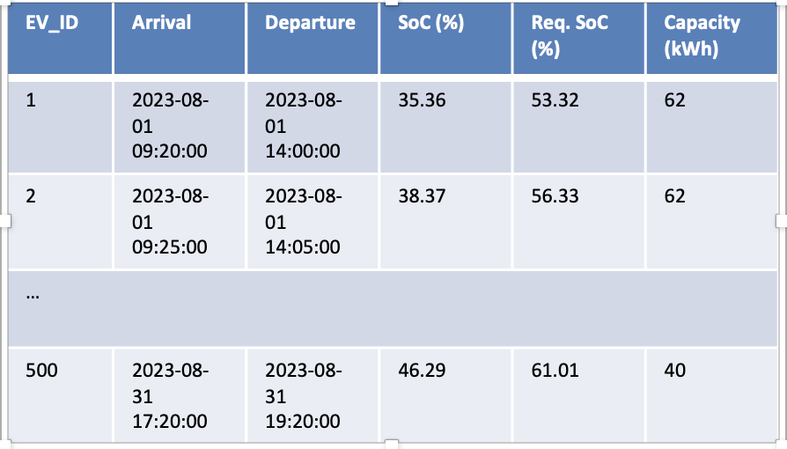
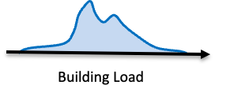
Proposed Approach: Simulator for V2B Charging Process
Training Sample
(Based on generative model)
(Events in entire month)
EV arrival/departures & SoC Requirements
Read new events at each time slot to:
EV Arrival/
Departure
Update for EV SoC
Building load flows
…
Update charger occupancy
Building Load
Read the current building load
9
Notes:
------------------
We designed a simulator for the EV charging process. Its input is training data containing multiple trajectories, each representing EV arrival schedules and other imporant environment information.
The simulator updates the state at each time slot by adjusting status of EV SoC , charger occupancy and the current building load
-------------------

Slide 11
Policy Guidance for Long-Term Rewards & Large Action Spaces
State or
Full trajectory to MILP solver
Stochastically integrate optimal actions to improve local optima
Mixed-Integer Linear Programming (MILP) Solver: optimize charging rates over the entire billing period.
Input to MILP Solver
State
Objective: Minimize the total bill
Constraints: Met EV charging requirements
Output: the next optimal action.
Future trajectory
Entire Billing period
10
Notes:
During RL training, we incorporate policy guidance by utilizing an MILP solver. The MILP solver uses the current state and future trajectory information to optimize charging rates over the remaining time, aiming to minimize the total electricity bill while meeting EV charging requirements. It mimics the RL policy by returning the next optimal action.
Policy Guidance: stochastically integrating optimal actions from the MILP solution into the replay buffer to improve local optima.
-----------------------------
During RL training, we use an MILP solver for policy guidance. The solver optimizes charging rates based on the current state and future trajectory, minimizing the electricity bill while meeting EV charging requirements. It mimics the RL policy by providing the next optimal action.
These optimal actions are stochastically integrated into the replay buffer alongside RL actions, providing high-quality guidance to help the policy escape local optima
——------------------------

Slide 12

Action Masking for Feasibility and Constraint Enforcement
Domain-specific Rules
Actor Network
State
Raw Action
Action Masking
Masked Action
Constraint 1: Set action to 0 if no EV is connected
Constraint 2: Stop charging uni-directional EVs upon reaching required SoC.
Constraint 3: Force charging/discharging EVs ensures they reach required SoC before departure.
Heuristic: Power improvement if current total power is lower than the estimated peak power.
Constraint 4: Ensure discharging power ≤ building load
MLP with ReLU activation and Tanh in the output layer
Differentiable Operations for modifying action
11
Notes:
We also implement an action masking approach. After the actor network generates raw actions, we pass them along with the state into an action masking function. This function applies a series of differentiable operations based on domain knowledge heuristics to update actions in a state-dependent manner.
For example, we set all actions to zero if no EVs are connected to chargers. Additionally, we enforce constraints such as ensuring EVs charge to their required SoC and greedily improving charging rates without increasing the demand charge. This action masking approach reduces exploration noise, focuses on valid actions, accelerates learning, and enhances policy performance.
-------------------------------------
After the actor network generates raw actions, we pass them along with the state into an action masking function. This function applies differentiable operations based on domain knowledge heuristics to refine actions.
For instance, we set the power rate to zero if no EV is connected to a charger. This action masking approach reduces exploration noise, focuses on valid actions, accelerates learning, and improves policy performance.
--------------------------------------

Slide 13
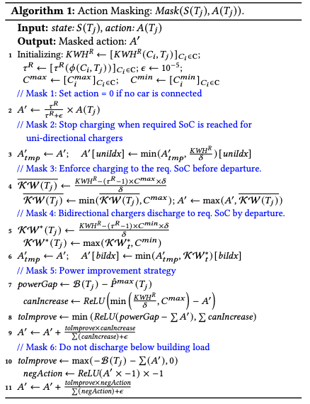
Domain-specific Rules

Slide 14
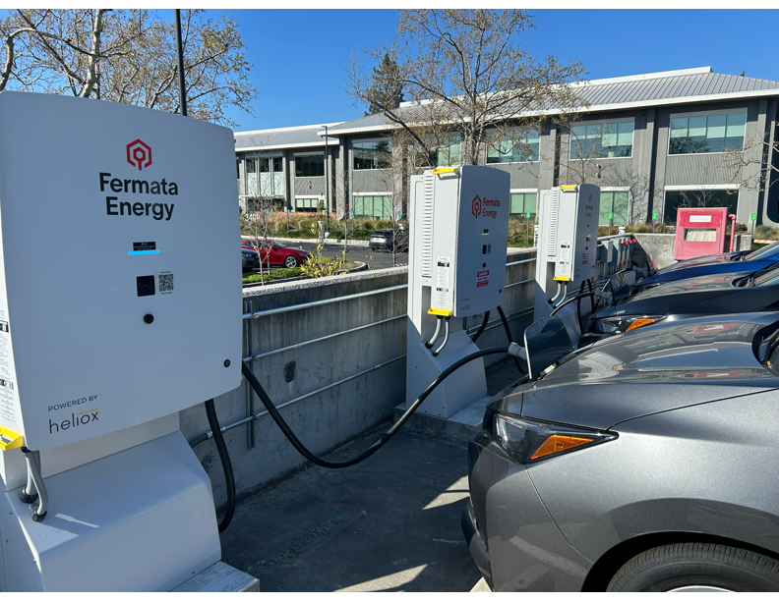
RL Training – Data Gathering & Processing
Data Collection: Collected data from EV meters at Nissan Advanced Technology Center - Silicon Valley from May 2023 – January 2024.
Downsampling: We applied k-means clustering to 1,000 samples, selecting 60 for training and 50 for testing.
Estimated Peak Power: We estimated this value based on the MILP solutions on training data.
RL Training: We trained 9 models for all months, did hyperparameter tuning through the cross-validation.
13
Notes:
To evaluate our proposed approaches, we collected real-world data from Nissan’s Santa Clara laboratory from May 2023 to January 2024. The training data was generated by clustering raw data and selecting representative samples. We also analyzed the data to estimate peak power.
We then trained an RL model for each month to determine the charging rates over the entire month, minimizing the monthly total bill.

Slide 15
Comparison of RL and Heuristics on Monthly Total Bill
Baselines:
Fast Charge (CF) [Real-world Policy]: Charges EVs at max rate until reaching required SoC..
Trickle: Uses a minimum trickle charging rate* to meet the required SoC before departure.
Trickle LLF (T-LLF) [Xu. et al. 2016] : Allocates the power gap* using the trickle rate, prioritized by laxity.
Trickle EDF (T-EDF): Same with T-LLF, but prioritizing by departure time.
Charge First LLF (CF-LLF): Overcharges when power gap* is fully allocated; uses trickle rate when power is insufficient, prioritizing laxity.
Charge First EDF (CF-EDF): Similar to CF-LLF, but prioritizes based on departure time.
Trickle Charging Rate*: Energy needed to reach the required SoC divided by the remaining stay duration.
Power Gap*: Estimated peak power minus building load.
14
Notes:
We compared our proposed approach with multiple baselines, including real-world charging policies and advanced scheduling heuristics such as EDF and LLF, which optimize based on the estimated peak power for long-term performance. These baselines also ensure EV charging requirements are met.

Slide 16
Comparison of RL and Heuristics on Monthly Total Bill
Total Bill ($): Monthly Energy Cost and Demand Charge (Lower is Better)
Policy | MAY | JUN | JULY | AUG | SEP | OCT | NOV | DEC | JAN | Total
RL (Ours) | 6222.6±26 | 6857.1±122 | 7392.2±51 | 9363.3±81 | 7243.0±24 | 7696.3±71 | 6654.9±61 | 6243.7±158 | 6635.0±80 | 64288.1
CF-LLF | 6245.9±32 | 6843.4±42 | 7396.8±26 | 9435.8±47 | 7284.1±41 | 7742.1±48 | 6675.9±32 | 6261.8±99 | 6646.3±81 | 64532.0
CF-EDF | 6247.6±34 | 6849.6±48 | 7399.0±28 | 9436.1±47 | 7289.5±48 | 7747.6±49 | 6676.3±31 | 6276.6±87 | 6639.9±69 | 64562.1
T-LLF | 6310.7±66 | 6920.0±75 | 7432.6±34 | 9537.5±52 | 7326.9±48 | 7800.1±48 | 6796.9±46 | 6344.5±132 | 6670.3±79 | 65139.7
T-EDF | 6326.6±58 | 6920.0±56 | 7455.4±34 | 9543.0±54 | 7364.5±48 | 7819.7±57 | 6809.7±42 | 6356.4±88 | 6673.2±60 | 65268.6
Trickle | 6333.8±44 | 6955.6±46 | 7506.0±37 | 9570.8±53 | 7402.1±47 | 7844.1±60 | 6842.9±44 | 6393.1±60 | 6706.8±53 | 65555.3
FC | 6308.7±50 | 6968.6±72 | 7537.3±83 | 9541.7±61 | 7403.6±81 | 7804.0±69 | 6813.0±70 | 6646.9±144 | 6706.4±77 | 65730.3
The RL policy outperformed all heuristics in 8 of 9 months, achieving $1,442.2 vs. the real-world strategy (FC).
15
Notes:
The results show that our proposed RL-trained model outperformed all baselines in most months, demonstrating its efficiency and effectiveness.

Slide 17
Comparison of RL and Heuristics on Peak Shaving
Peak Shaving ($): Mean difference in demand charges with and without EV charging over 9 months (Values greater than 0 indicate successful peak shaving — higher is better).
Policy | RL (Ours) | CF-LLF | CF-EDF | T-LLF | T-EDF | Trickle | FC
Average Peak Shaving ($) | 22.13 | -2.86 | -6.2 | -70.48 | -84.81 | -116.68 | -142.07
The RL policy achieved peak shaving over 9 months, reducing demand charges compared to no charging.
16
Notes:
We also evaluated the policy’s performance in peak shaving by comparing the final demand charge with a scenario without charging operations. The results indicate that our RL-trained policy effectively reduces the demand charge (achieving peak shaving) in multiple months.
We also evaluated the policy’s performance in peak shaving by comparing the final demand charge with a scenario without charging operations. The results indicate that our RL-trained policy effectively reduces the demand charge (achieving peak shaving) in multiple months.
We also conducted ablation studies to emphasize the importance of key components in our approach, such as policy guidance, action masking, and the usage of estimated peak power in improving policy performance.

Slide 18
Ablation Study: Monthly Total Bills from May to July 2023
RL (Ours) | RL\500 | RL\C | RL\F | RL\E | RL\P | RL\A | Random\A
20471.9 ± 137 | 20494.8 ± 174 | 20511.6 ± 184 | 20594.1 ± 181 | 21130.2 ± 214 | 21157.0 ± 204 | 21273.7 ± 209 | 21627.3 ± 180
RL\500: Trained with 500 samples.
RL\C: Trained using 60 randomly selected samples from 1000 generated.
RL\F: Utilized all 100 complete state features.
RL\E: Monthly estimated peak power is set to 0.
RL\P: Training without policy guidance.
RL\A: Training without action masking
Random\A: Actions randomly selected instead of using a trained actor network, followed by action masking.
Results highlight the significance of downsampling, state definition, action masking, policy guidance, and estimated peak power.
17
Notes:
We conducted ablation studies over three months, comparing policy performance with models trained without key components such as policy guidance, action masking, data processing, abstracted MDP state definitions, and the inclusion of estimated peak power. The results emphasize the importance of these design choices in enhancing policy performance.

Slide 19

Conclusion
Modeling V2B problem as an MDP: we formulate the V2B problem as a Markov Decision Process (MDP) for long-term optimization.
Novel RL Techniques: we introduced policy guidance and action masking to improve RL training efficiency and performance.
Real-World Validation: we validate the approach using real-world EV data, achieving significant cost savings, outperforming heuristics, and meeting all EV charging demands.
Future Work: Community-based EV charging optimization across multiple buildings, incorporating (Distribution System Operator) DSO commands.
Paper Link:
See you in the Poster Session!
18
Notes:
To conclude, this work makes several key contributions: we modeled the V2B problem as an MDP for long-term optimization, developed novel RL techniques like policy guidance and action masking to improve training, and validated our approach using real-world EV data, achieving significant cost savings and outperforming heuristics while meeting all EV charging requirements
Thank you for your time and attention.

Slide 20
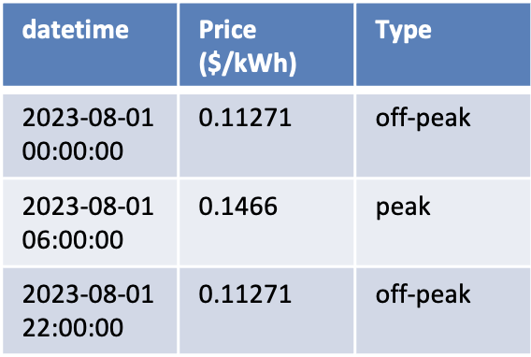
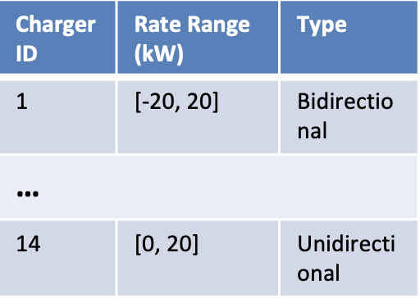
Proposed Approach: Simulator for V2B Charging Process
Data for Each Trajectory
EV Arrival/
Departure
Read new events at each time slot to:
Building Load
Update for EV SoC
Grid Price
Charger Information
Update charger occupancy
Read the current building load
Estimated Peak Power
19
Notes:
------------------
We designed a simulator for the EV charging process. Its input is training data containing multiple trajectories, each representing EV arrival schedules and other imporant environment information.
The simulator updates the state at each time slot by adjusting status of EV SoC , charger occupancy and the current building load
-------------------

Slide 21
Comparison of RL and Heuristics on Monthly Total Bill
Total Bill ($): Monthly Energy Cost and Demand Charge (Lower is Better)
Policy | MAY | JUN | JULY | AUG | SEP | OCT | NOV | DEC | JAN | Total
MILP (Oracle) | 6201.1±50 | 6713.3±61 | 7371.0±40 | 9308.9±51 | 7231.0±36 | 7640.6±66 | 6625.9±42 | 6079.8±54 | 6495.1±55 | 63666.9
RL (Ours) | 6222.6±26 | 6857.1±122 | 7392.2±51 | 9363.3±81 | 7243.0±24 | 7696.3±71 | 6654.9±61 | 6243.7±158 | 6635.0±80 | 64288.1
CF-LLF | 6245.9±32 | 6843.4±42 | 7396.8±26 | 9435.8±47 | 7284.1±41 | 7742.1±48 | 6675.9±32 | 6261.8±99 | 6646.3±81 | 64532.0
CF-EDF | 6247.6±34 | 6849.6±48 | 7399.0±28 | 9436.1±47 | 7289.5±48 | 7747.6±49 | 6676.3±31 | 6276.6±87 | 6639.9±69 | 64562.1
T-LLF | 6310.7±66 | 6920.0±75 | 7432.6±34 | 9537.5±52 | 7326.9±48 | 7800.1±48 | 6796.9±46 | 6344.5±132 | 6670.3±79 | 65139.7
T-EDF | 6326.6±58 | 6920.0±56 | 7455.4±34 | 9543.0±54 | 7364.5±48 | 7819.7±57 | 6809.7±42 | 6356.4±88 | 6673.2±60 | 65268.6
Trickle | 6333.8±44 | 6955.6±46 | 7506.0±37 | 9570.8±53 | 7402.1±47 | 7844.1±60 | 6842.9±44 | 6393.1±60 | 6706.8±53 | 65555.3
FC | 6308.7±50 | 6968.6±72 | 7537.3±83 | 9541.7±61 | 7403.6±81 | 7804.0±69 | 6813.0±70 | 6646.9±144 | 6706.4±77 | 65730.3
The RL policy outperformed all heuristics in 8 of 9 months, achieving $1,442.2 vs. the real-world strategy (FC).
20
Notes:
The results show that our proposed RL-trained model outperformed all baselines in most months, demonstrating its efficiency and effectiveness.

Slide 22
Comparison of RL and Heuristics on Peak Shaving
Peak Shaving ($): The difference in demand charges without and with EV charging operations (Higher is Better)
Policy | MAY | JUN | JULY | AUG | SEP | OCT | NOV | DEC | JAN
RL (Ours) | 31.7±28 | 3.8±61 | -1.7±46 | 140.3±97 | 13.1±14 | 39.8±72 | 92.6±67 | -59.2±152 | -61.2±77
CF-LLF | 8.3±34 | 17.4±43 | -6.3±21 | 67.9±41 | -28.0±28 | -6.5±38 | 71.1±37 | -77.2±92 | -72.4±83
CF-EDF | 6.5±33 | 11.2±50 | -8.5±24 | 67.5±41 | -33.4±34 | -12.0±40 | 70.7±38 | -91.9±81 | -65.9±68
T-LLF | -56.7±62 | -59.2±73 | -42.1±40 | -33.9±40 | -70.9±42 | -64.6±41 | -50.1±38 | -160.2±126 | -96.6±76
T-EDF | -72.6±54 | -59.3±53 | -64.9±30 | -39.4±41 | -108.5±38 | -84.2±52 | -62.8±37 | -172.1±82 | -99.5±58
Trickle | -79.8±39 | -94.9±46 | -115.5±36 | -67.1±34 | -146.1±38 | -108.6±48 | -96.1±36 | -208.8±53 | -133.2±49
FC | -57.1±46 | -113.7±70 | -151.3±85 | -40.8±42 | -155.1±73 | -76.0±59 | -70.8±72 | -473.5±138 | -140.3±76
The RL policy achieved peak shaving in 6 of 9 months, reducing demand charges compared to no charging.
21
Notes:
We also evaluated the policy’s performance in peak shaving by comparing the final demand charge with a scenario without charging operations. The results indicate that our RL-trained policy effectively reduces the demand charge (achieving peak shaving) in multiple months.
We also evaluated the policy’s performance in peak shaving by comparing the final demand charge with a scenario without charging operations. The results indicate that our RL-trained policy effectively reduces the demand charge (achieving peak shaving) in multiple months.
We also conducted ablation studies to emphasize the importance of key components in our approach, such as policy guidance, action masking, and the usage of estimated peak power in improving policy performance.

Slide 23
Comparison of RL and Heuristics on Monthly Total Bill
Total Bill ($): Monthly Energy Cost and Demand Charge (Lower is Better)
Policy | MAY | JUN | JULY | AUG | SEP | OCT | NOV | DEC | JAN | Total
MILP (Oracle) | 6201.1±50 | 6713.3±61 | 7371.0±40 | 9308.9±51 | 7231.0±36 | 7640.6±66 | 6625.9±42 | 6079.8±54 | 6495.1±55 | 63666.9
RL (Ours) | 6222.6±26 | 6857.1±122 | 7392.2±51 | 9363.3±81 | 7243.0±24 | 7696.3±71 | 6654.9±61 | 6243.7±158 | 6635.0±80 | 64288.1
CF-LLF | 6245.9±32 | 6843.4±42 | 7396.8±26 | 9435.8±47 | 7284.1±41 | 7742.1±48 | 6675.9±32 | 6261.8±99 | 6646.3±81 | 64532.0
CF-EDF | 6247.6±34 | 6849.6±48 | 7399.0±28 | 9436.1±47 | 7289.5±48 | 7747.6±49 | 6676.3±31 | 6276.6±87 | 6639.9±69 | 64562.1
T-LLF | 6310.7±66 | 6920.0±75 | 7432.6±34 | 9537.5±52 | 7326.9±48 | 7800.1±48 | 6796.9±46 | 6344.5±132 | 6670.3±79 | 65139.7
T-EDF | 6326.6±58 | 6920.0±56 | 7455.4±34 | 9543.0±54 | 7364.5±48 | 7819.7±57 | 6809.7±42 | 6356.4±88 | 6673.2±60 | 65268.6
Trickle | 6333.8±44 | 6955.6±46 | 7506.0±37 | 9570.8±53 | 7402.1±47 | 7844.1±60 | 6842.9±44 | 6393.1±60 | 6706.8±53 | 65555.3
FC | 6308.7±50 | 6968.6±72 | 7537.3±83 | 9541.7±61 | 7403.6±81 | 7804.0±69 | 6813.0±70 | 6646.9±144 | 6706.4±77 | 65730.3
The RL policy outperformed all heuristics in 8 of 9 months, achieving $1,442.2 vs. the real-world strategy (FC).
22
Notes:
The results show that our proposed RL-trained model outperformed all baselines in most months, demonstrating its efficiency and effectiveness.

Slide 24
Action Masking for Feasibility and Constraint Enforcement
Domain-specific Rules
Actor Network
State
Raw Action
Action Masking
Masked Action
Constraint 1: Set action to 0 if no EV is connected
Constraint 2: Stop charging uni-directional EVs upon reaching required SoC.
Constraint 3: Force charging/discharging EVs ensures they reach required SoC before departure.
Heuristic: Power improvement if current total power is lower than the estimated peak power.
Constraint 4: Ensure discharging power ≤ building load
MLP with ReLU activation and Tanh in the output layer
Differentiable Operations for modifying action
23
Notes:
We also implement an action masking approach. After the actor network generates raw actions, we pass them along with the state into an action masking function. This function applies a series of differentiable operations based on domain knowledge heuristics to update actions in a state-dependent manner.
For example, we set all actions to zero if no EVs are connected to chargers. Additionally, we enforce constraints such as ensuring EVs charge to their required SoC and greedily improving charging rates without increasing the demand charge. This action masking approach reduces exploration noise, focuses on valid actions, accelerates learning, and enhances policy performance.
-------------------------------------
After the actor network generates raw actions, we pass them along with the state into an action masking function. This function applies differentiable operations based on domain knowledge heuristics to refine actions.
For instance, we set the power rate to zero if no EV is connected to a charger. This action masking approach reduces exploration noise, focuses on valid actions, accelerates learning, and improves policy performance.
--------------------------------------

