Slide 1

HSCC/ICCPS 2026
P-V2B : A Neuro-Symbolic Framework for Leveraging User Persistence in Vehicle-to-Building Charging
Rishav Sen · Fangqi Liu · Jose Paolo Talusan · Ava Pettet · Yoshinori Suzue · Ayan Mukhopadhyay · Abhishek Dubey
Vanderbilt University · Nissan Advanced Technology Center - Silicon Valley
Thanks to our collaborators at Nissan Advanced Technology Center - Silicon Valley.
Work supported in part by the National Science Foundation.
Notes:
Hi everyone — I'm going to tell you about P-V2B, a neuro-symbolic framework for controlling EV charging in commercial buildings. This is joint work with my collaborators at Vanderbilt and Nissan. The headline idea is simple: the people who plug in at your office tomorrow are probably the same people who plugged in today — and if you know that, you can be a lot smarter about how you charge their cars. I'll explain why that matters, why prior work missed it, and how we turned it into a real-time controller that gets close to the offline optimum.

Slide 2


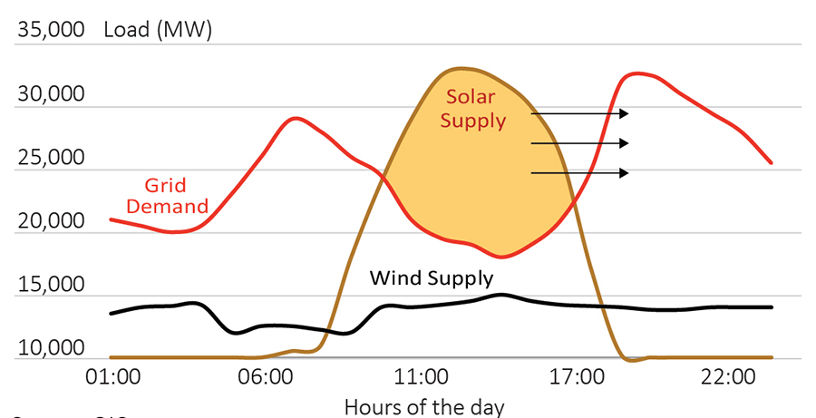
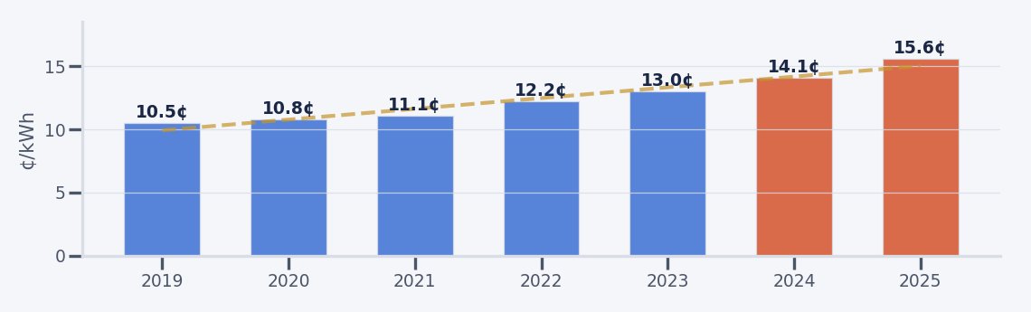
02 / 26
MOTIVATION
The Grid is under pressure
SUPPLY–DEMAND MISMATCH
ESCALATING ENERGY COSTS
The Missing Piece Is Not the Hardware - EVs can serve as mobile batteries.
Every major city has EVs with 60–130 kWh of usable battery sitting idle most of the day.
Notes:
Maarten: (~1 min)
Let's start with why this matters. Power grids are under growing strain from multiple directions.
First, there's a fundamental mismatch — solar generates the most energy midday when demand is lowest, then drops off right when evening demand ramps up. That creates the famous 'duck curve.’
Meanwhile, electricity costs have climbed roughly 50% in just six years — from about 10.5 cents per kilowatt-hour in 2019 to over 15.6 cents in 2025.

Slide 3

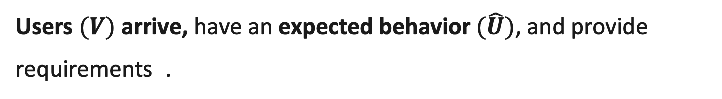
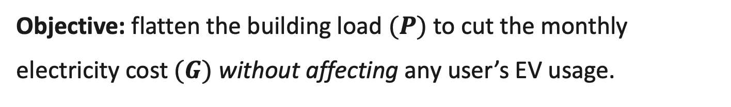
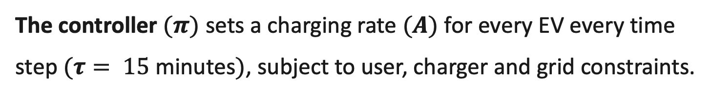

03 / 26
THE VEHCILE to BUILDING (V2B) SETUP
EVs are (uncertain) mobile batteries for a building.
1
Users $(V)$ arrive, have an expected behavior $(\hat{U})$, and provide requirements .
From Grid
From EV
2
Connect to Chargers $(C)$(unidirectional & bidirectional).
Req. SoC
Departure window
3
The controller $(π)$ sets a charging rate $(A)$ for every EV every time step $(τ= 15$ minutes$)$, subject to user, charger and grid constraints.
Bi-directional
Req. SoC
Departure window
Objective: flatten the building load $(P)$ to cut the monthly electricity cost $(G)$ without affecting any user’s EV usage.
4
Bi-directional
Notes:
Now here's the setup. You have a building, you have the grid feeding it, and you have a fleet of EVs that show up with bidirectional chargers. The user tells the system: I need this much charge by this time. The controller decides how fast to charge each car, and critically, when to discharge them back into the building. The goal is to flatten the load curve — pull energy from the grid when demand is low, and push it back from the EVs when the building would otherwise spike. That's vehicle-to-building, or V2B.

Slide 4

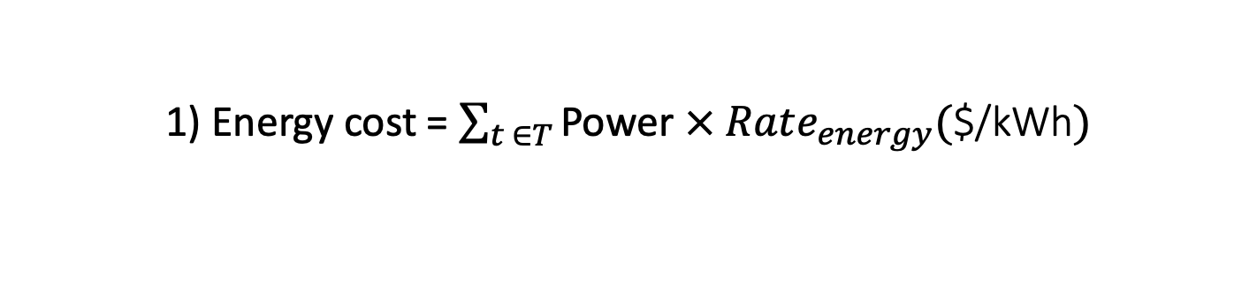

04 / 26
ELECTRICITY COST
Vehicle-to-Building (V2B) Problem: Goals
Electricity Cost $(G)$ depends on:
1) Energy cost = $\sum_{t ∈T}{\text{Power}}$ $×$ $Rate_{energy}($$/kWh$)$
Off-Peak Rate: $0.1/kWh
Peak Hour Rate: $0.2/kWh
Demand Charge: $12/KW
2) Demand charge = Peak Power draw $×$ $Rate_{demand}($$/kW$)$
Off-peak
Peak hour
Off-peak
Peak Building Load
Off-peak
Peak hour
Off-peak
Building
Power
Total Power
(Building
+Chargers)
Peak Building Load
0
Optimized Peak
$$+$$
EV stay duration
Charging
Rate
0
Charging
Rate
0
Notes:
in a way that minimizes the total electricity bill. The bill has two parts: energy cost for energy consumption for the building and EVs, and demand charges, which depend on the peak power draw in peak hours during the billing period. At the same time, we need to make sure all EV charging needs are met.
--------------------
Addressing this problem presents several challenges. Real-time decision-making is required in an uncertain environment with varying EV arrivals, charging needs, and building loads over time, making offline optimization and simple heuristics ineffective.
Additionally, decisions must be made in a continuous action space while optimizing long-term rewards, such as minimizing monthly demand charges. Traditional RL methods, designed for simpler environments with discrete actions, struggle with these complexities and face the curse of dimensionality at scale.
-----------------------
Traditional energy distribution is centralized
But with the addition of distributed energy resources transferring energy back to the main grid became is an option.
This also provides the opportunity for transferring energy directly between agents.

Slide 5
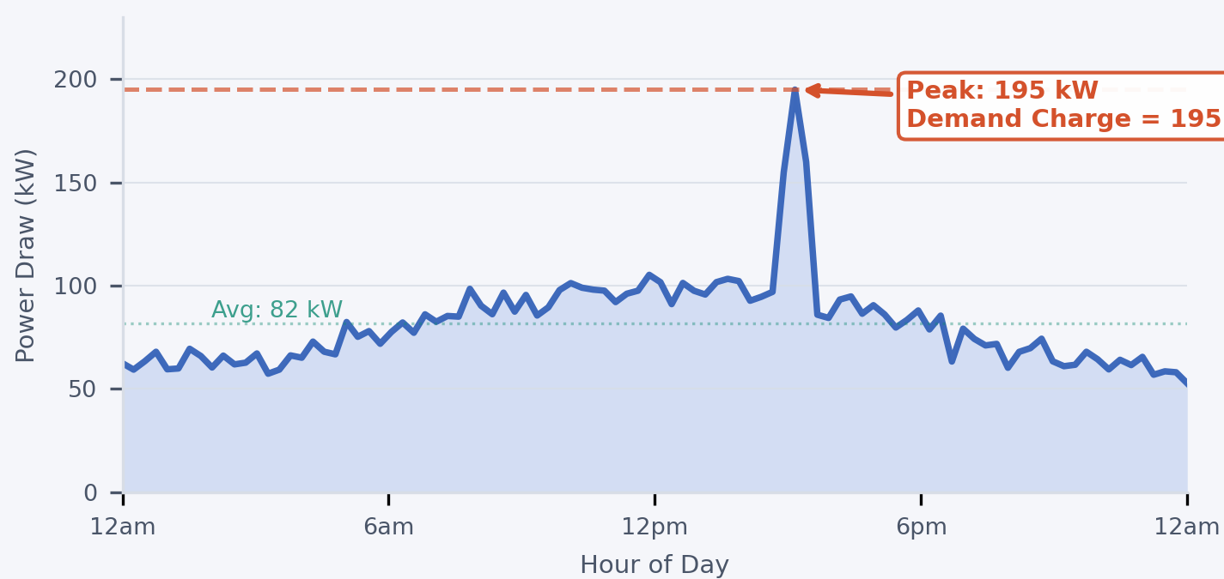
05 / 26
THE PROBLEM
Demand charges dominate commercial electricity bills.
The operators are charged for:
how much energy is used.
single highest moment of use.
30%+
One bad afternoon leads to a much higher costs for the entire billing cycle.
of a commercial building's monthly electricity bill comes from sudden power spikes (demand charges).
[1] NREL: Identifying Potential Markets for Behind-the-Meter Battery Energy Storage: A Survey of U.S. Demand Charges
[2] LBNL: Exploring Demand Charge Savings from Commercial Solar
Notes:
So why should you care about peaks? For commercial and industrial buildings, your electricity bill has two pieces: the energy you use, and one number — the single highest kilowatt spike in a given month. That single moment can account for more than 30% of the bill. One bad afternoon can cost you as much as everything else combined. So if you can shave that peak — even by a little — the financial impact is huge. This is what's called the demand charge, and it's the thing we're really optimizing against.

Slide 6
06 / 26
V2B PROGRESS
Focus now on Human in the Loop
2026
Our V2B Research
ICCPS
P-V2B
Simulation → Online Control → Learning
Neuro-Symbolic
MPV + VF control
2024
2025
2025
SMARTCOMP
ICCPS
AAMAS★
2026
AAMAS (accepted)
CONSENT
OPTIMUS
DG-MCTS
RL-V2B
User
Negotiation with guarantees
Discrete V2B Simulation
platform
Online, robust
Decision-making without training
Fast, online, constrained decisions under sparse rewards
★ = Nominated for Best Paper (Top 5)

Slide 7
07 / 26
V2B RESEARCH PROGRESS
Additional Strategies: Human in the Loop
User Negotiation
EV users have flexibility — tap into it
Share savings cooperatively: operator & user both profit
Unlock savings that conservative optimization misses
Employee Persistence
Same employees, same cars, day after day
Predictable patterns = deeper optimization potential
Personalized schedules per user profile
Building/
Operator
$
EV User
Mon
Tue
Wed
Thu
Fri
Shared savings through negotiated contracts
Same employee, same car, predictable pattern
→ Personalized schedules yield deeper savings
CONSENT: Human-Centered Negotiation
AAMAS 2026 (accepted)
P-V2B: Neuro-Symbolic Control with Persistence
ICCPS 2026
Notes:
Abhishek
"We also realized that in a workplace setting, the same employees bring the same cars day after day."
"Those predictable patterns unlock deeper optimization — personalized schedules per user profile that compound savings over time."
"This became P-V2B, our neuro-symbolic control system with persistence, accepted at ICCPS 2026."

Slide 8
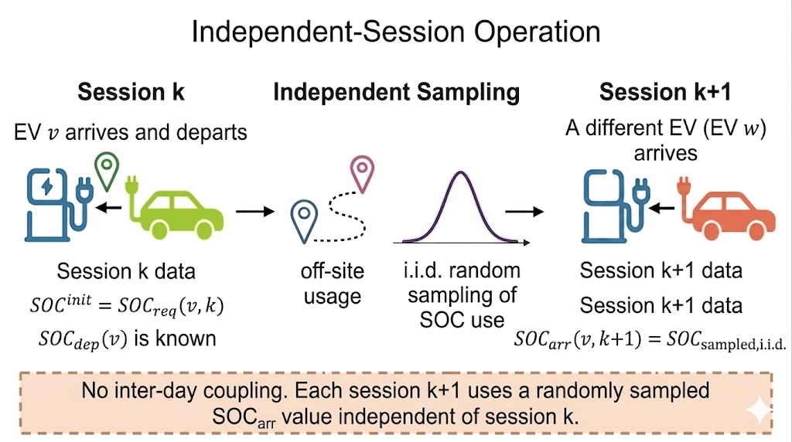
08 / 26
THE GAP
Transient-fleet (No Persistence)
Prior V2B work treats every day as an island. Each EV’s arrival SoC is not related to its past activity.
Sampled arrival SoC
No inter-day Coupling
[1] Tanguy, et al. "Optimization model and economic assessment of collaborative charging using Vehicle-to-Building." Sustainable Cities and Society 26 (2016
[2] Sen, et al. “Online decision-making under uncertainty for vehicle-to-building systems”, ICCPS 2025
[3] Liu, et al. “Reinforcement learning-based approach for vehicle-to-building charging with heterogeneous agents and long term rewards”, AAMAS 2025
Notes:
Here's where we differ from prior work. Almost every published V2B controller treats the problem one day at a time. A car arrives, they solve a daily optimization, the car leaves, they throw away state, and the next day starts fresh. This is called the transient-fleet assumption. It's tractable, but it assumes every EV is a stranger.
Existing Approaches?
Before our work
Our work (CPS problem with online decision making) (brief recap)
Missing - > Ignored human element,: i. realize employees come back (actions today -> impact tomorrow)
Negotiation with humans –(CONSENT, give QR code, tbd at AAMAS )
Next->

Slide 9
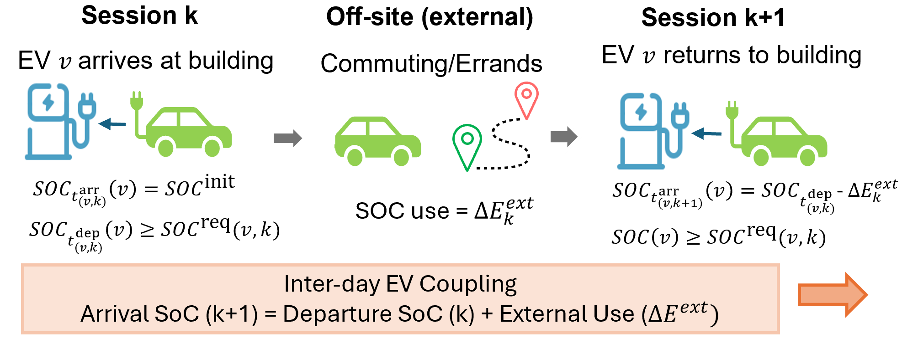
09 / 26
THE APPROACH
Persistent EV fleet
SoC carries across. Each EV’s arrival SoC is related to its last charging, and off-site use.
Additional block for Persistence
Mon
Tue
Wed
Thu
Fri
Notes:
Here's where we differ from prior work. Almost every published V2B controller treats the problem one day at a time. A car arrives, they solve a daily optimization, the car leaves, they throw away state, and the next day starts fresh. This is called the transient-fleet assumption. It's tractable, but it assumes every EV is a stranger.

Slide 10
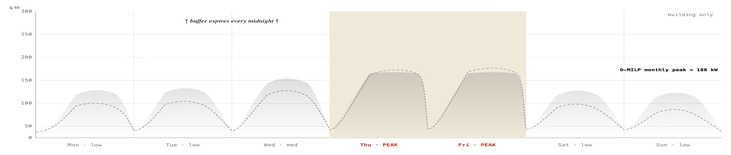
10 / 26
THE OPPORTUNITY
Non-Persistent EV fleet, 1 building.
Example: Without Persistence in V2B (oracle solution)
building only
D-MILP
daily oracle
building load + V2B controller output · 15-min
D-MILP peak = 188kW
Combined Power use (kW)
Notes:
So our answer is a neuro-symbolic hybrid. The symbolic half is a Monte Carlo Model Predictive Controller — it looks ahead to the end of the day, enforces all the physical and user constraints, and handles uncertainty by averaging over sampled futures. The neural half is a learned value function that estimates the cost-to-go from the end of the day all the way to the end of the billing cycle. The MPC gets the short-horizon feasibility right; the value function supplies the long-horizon strategy. They talk to each other through a terminal cost in the MPC objective.

Slide 11
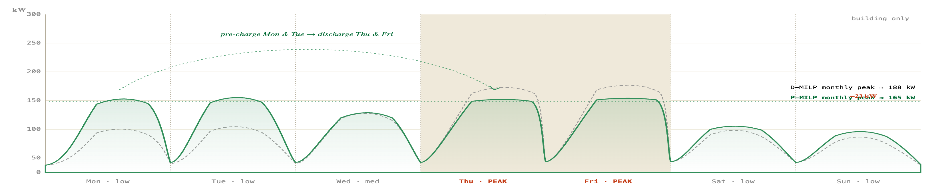
11 / 26
THE OPPORTUNITY
Persistent EV fleet, 1 building.
Example: Effect of Persistence in V2B (oracle solutions)
D-MILP
daily oracle
P-MILP
monthly oracle
building load + V2B controller output · 15-min · kW
Pre-charge more on Monday & Tuesday $−>$ Discharge heavily on Thursday & Friday
D-MILP peak = 188kW
P-MILP peak = 165kW
Gap: 23kW
Combined Power use (kW)
Notes:
So our answer is a neuro-symbolic hybrid. The symbolic half is a Monte Carlo Model Predictive Controller — it looks ahead to the end of the day, enforces all the physical and user constraints, and handles uncertainty by averaging over sampled futures. The neural half is a learned value function that estimates the cost-to-go from the end of the day all the way to the end of the billing cycle. The MPC gets the short-horizon feasibility right; the value function supplies the long-horizon strategy. They talk to each other through a terminal cost in the MPC objective.

Slide 12
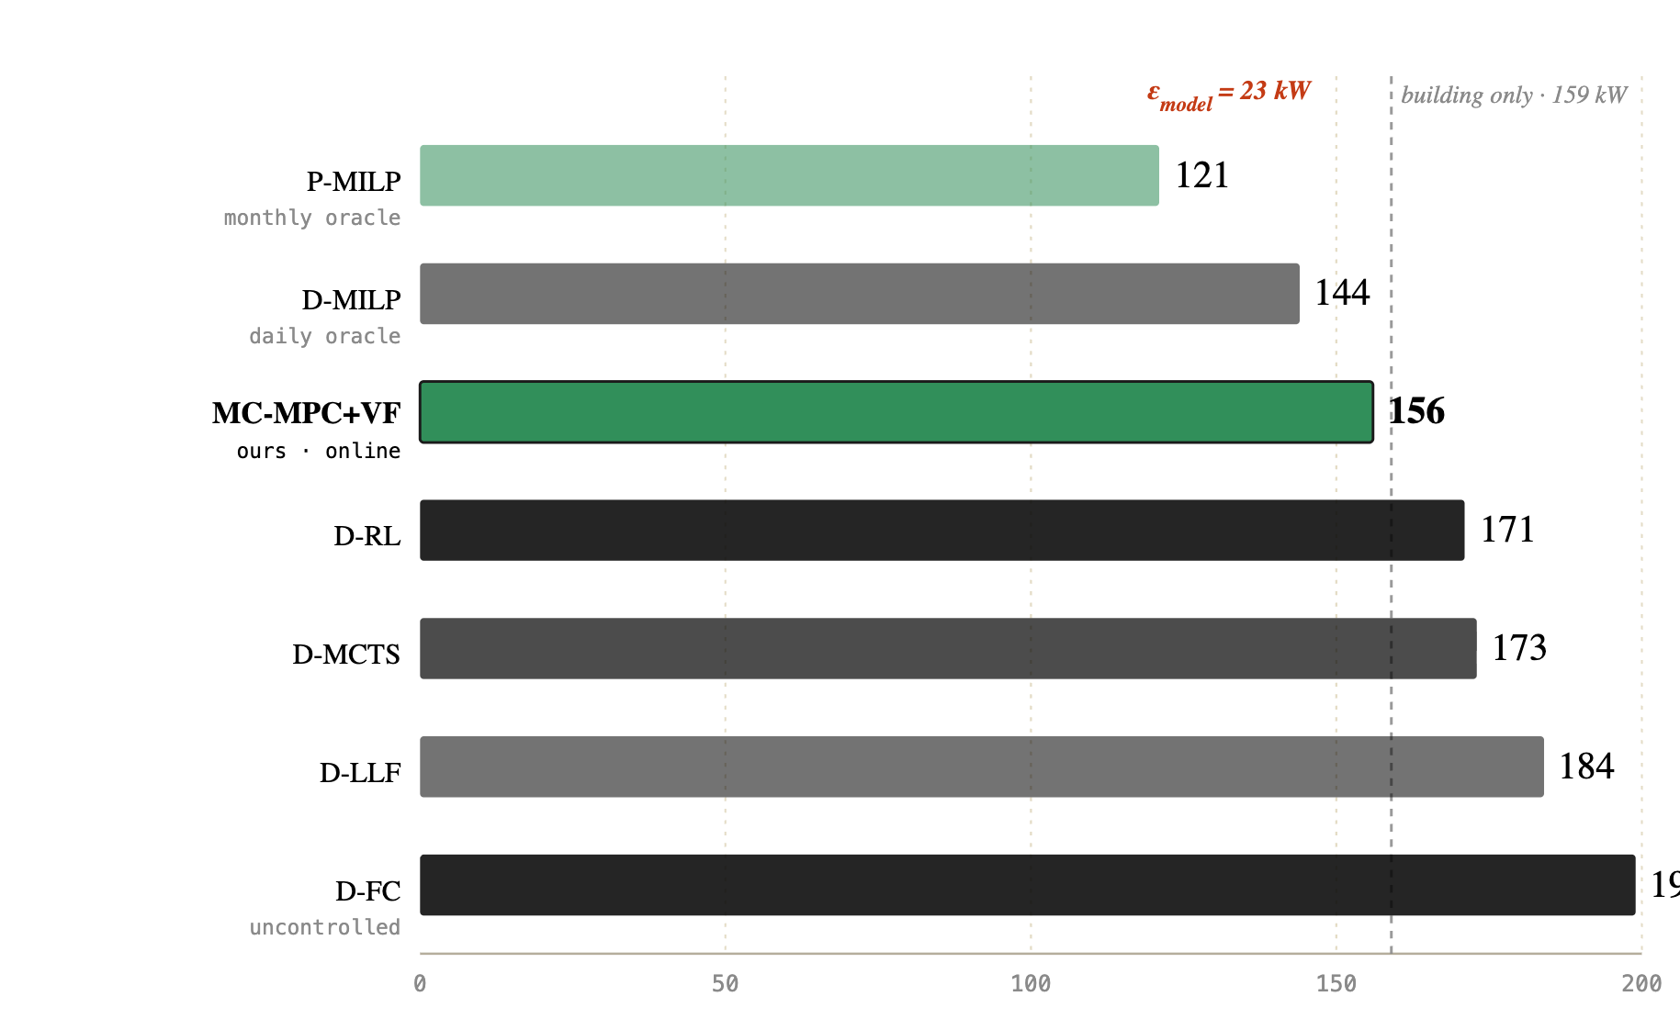

12 / 26
THE OPPORTUNITY
Daily decomposition is a strict subset of monthly control.
THEOREM
HOW THE CONTROLLERS COMPARE
Experimentally,
Total cost under Persistence
Φ_{P}⋆
≤
Φ_{D}⋆
Total Cost under daily-decomposition
$ε_{model}=$$267
The optimal persistent-fleet cost is never worse than the optimal daily-decomposed cost and is generally strictly better.
$9,791
$10,058
i.
Every daily-feasible plan is also monthly-feasible, so 𝒜_{D} ⊆ 𝒜_{P}.
ii.
The monthly objective minimises over a strictly larger set of strategies.
No amount of better daily policies can close ε_{model} . We have to change the scope of the controller.
iii.
Therefore the gap ε_{model} = Φ_{D}⋆ − Φ_{P}⋆ ≥ 0 is structural, not algorithmic.
Notes:
Of course, actually solving this online is hard for three reasons. First, everything is stochastic — arrivals, departures, building load. Second, decisions are coupled across days — what you do Monday changes what's feasible Friday, which means the reward is delayed by up to a month. And third, the action space is continuous and high-dimensional — you're setting a charging rate for every car at every fifteen-minute interval. Classical RL struggles with delayed rewards. Classical MPC can't see past its horizon. Neither alone is enough.

Slide 13
13 / 26
THE CHALLENGES
Three challenges for online control.
01
02
03
Stochastic users and stochastic loads.
Long term rewards.
Continuous, high-dimensional actions.
Arrivals, departures, charging needs, and building load all have uncertainty.
Deterministic MPC and heuristics degrade under noise.
One demand-charge signal. Revealed once per month.
Today's decision changes next week's feasible set: RL-style credit assignment is brittle.
Decide charging rate per EV per 15 minutes.
Policy search and tree search both struggle on the dimensionality.
Aleatoric + Epistemic uncertainty
Horizon = 30 days × 96 steps
15 chargers × [-20kW, 20 kW]
Notes:
So our answer is a neuro-symbolic hybrid. The symbolic half is a Monte Carlo Model Predictive Controller — it looks ahead to the end of the day, enforces all the physical and user constraints, and handles uncertainty by averaging over sampled futures. The neural half is a learned value function that estimates the cost-to-go from the end of the day all the way to the end of the billing cycle. The MPC gets the short-horizon feasibility right; the value function supplies the long-horizon strategy. They talk to each other through a terminal cost in the MPC objective.

Slide 14
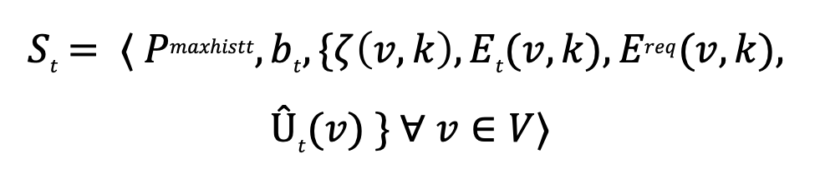
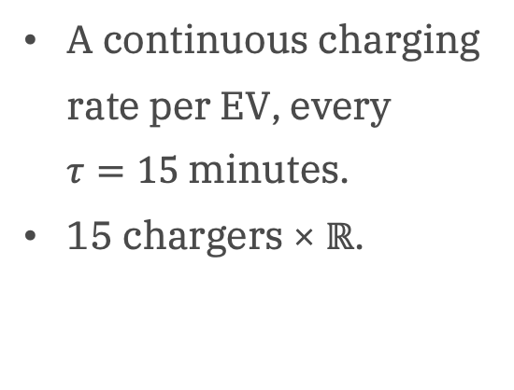
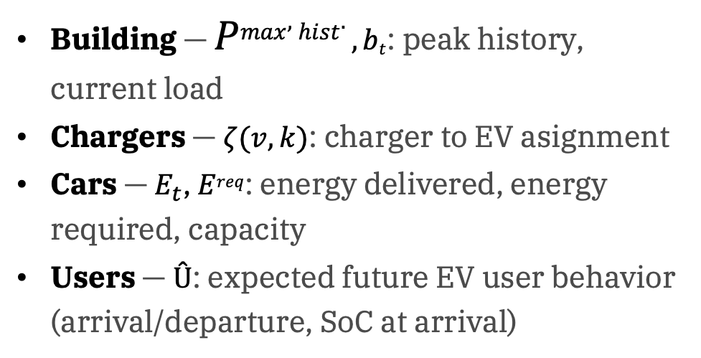
14 / 26
THE FORMULATION
A monthly MDP. The reward arrives once.
STATE · S_{T}
ACTION · A_{T}
REWARD · R
$$St= ⟨ Pmaxhistt, bt, \{ζ\left(v,k\right), Et(v,k), Ereq(v,k),$$
$$Ût(v) \} ∀ v∈V⟩$$
A_{t} = {charging rate for connected EV} ∈ [r_{min}, r_{max}]
R = − Φ_{total} = − ( Σ_{j} φ_{energy,j} + φ_{demand})
Building — $Pmax,hist. ,bt$: peak history, current load
Chargers — $ζ(v,k)$: charger to EV asignment
Cars — $E_{t}$, $Ereq$: energy delivered, energy required, capacity
Users — $Û$: expected future EV user behavior (arrival/departure, SoC at arrival)
A continuous charging rate per EV, every $τ=15$minutes.
15 chargers × ℝ.
Φ_{total} is Total bill is a sum across 30 × 96 ≈ 2,880 timesteps.
φ_{energy,j} is the energy cost (ToU charges)
φ_{demand} is the demand charge on max. power use (w_{d} · max _{j} P_{j}), revealed at month-end.
Notes:
And that changes everything. Because now, on a low-demand Monday, you can deliberately over-charge a user's battery beyond what they asked for. That extra energy sits in their car overnight, drives home with them, comes back Tuesday morning — and now you have a pre-positioned battery ready to discharge during Friday's peak. It's a multi-day strategy that is structurally invisible to daily-decomposed controllers. We call this the Persistent V2B problem, or P-V2B.

Slide 15

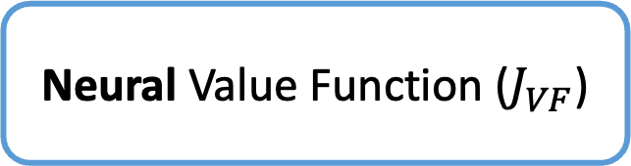




15 / 26
THE APPROACH
MC-MPC for feasibility. A learned value function for foresight.
Neural Value Function ($J_{VF}$)
System State
$$S_{t}$$
(load, SoC, arrivals)
Predicted
Peak monthly power $({\hat{P}}_{\text{max}})$
Sampling
$N_{f}$Monte Carlo (MC) futures
Proactive Charging
Fills charging headroom below ${\hat{P}}_{\text{max}}$
Action $A_{t}$
Charging/
Discharging rates for each charger
Symbolic Monte Carlo Model Predictive Control (MC-MPC)
Maintains Physical & User constraints
OBJECTIVE: $min⁡𝔼F [Φenergy + Φdemandeod+ JVF(Seod)− wpc·Σv,k rv,kj·Δt]$
Notes:
Let's unpack the MPC side. At every fifteen-minute control step, we sample ten possible futures for the rest of the day — different arrival patterns, different load realizations. We then solve one MILP that has to commit to a single first-stage action good across all ten scenarios. This is sample average approximation, and it gives us robustness against both arrival noise and load-forecast error. Constraints in this MILP guarantee every user gets the charge they asked for before they leave. Nobody's cheated out of their commute.

Slide 16
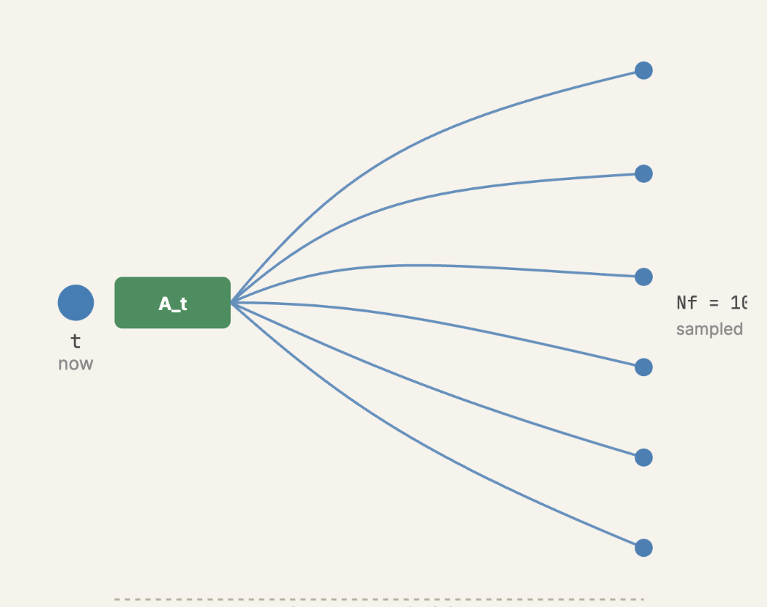
16 / 26
THE SYMBOLIC HALF
MC-MPC: one constrained action for the current state.
Sample Average Approximation
Sample N_{f} futures. Solve one MILP.
Multiple trajectories per decision epoch: different arrivals, different load realizations.
A single MILP enforces identical first-stage actions across all of them.
N_{f}
Feasibility, not probability.
samples
Physical constraints guarantee charging assignments & limits, maintain SoC curves.
Every user is guaranteed their required SoC at departure.
≈2 seconds per decision.
Comfortably within the 15-minute control window, and scales to 45 chargers without breaking that budget.
Horizon: end of day
Notes:
The value function is where the cross-day strategy lives. We don't feed it the full state — that would be enormous. Instead, we cluster users into three groups by how often they visit, and we summarize the end-of-day state with just three numbers: how much excess charge is sitting in each cluster. The VF maps those three numbers, plus the day of the month, to the expected residual demand charge. One nice engineering detail: embedding a ReLU network inside a MILP with Big-M constraints blows up to five-plus minutes per decision. So we approximate the VF with a trilinear piecewise-linear surrogate — twenty grid points per axis — and we're back down to about two seconds per decision.

Slide 17
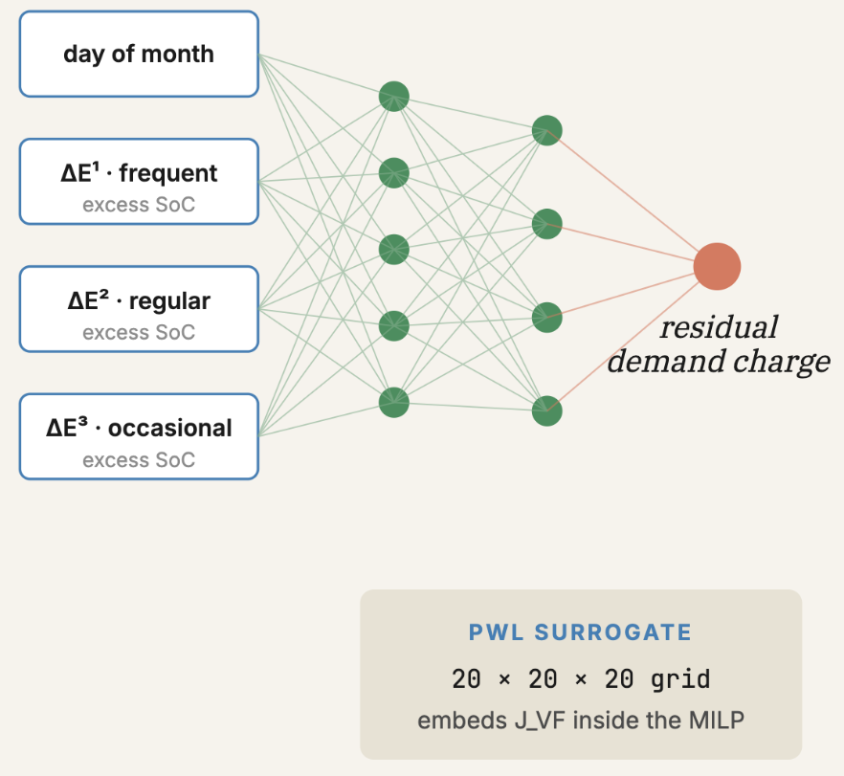
17 / 26
THE NEURAL HALF
The Value Function (VF) predicts the effect of actions on rest of the month.
Compact end-of-day abstraction
Cluster users into 3 groups.
Bucket by historical arrival frequency and stay duration.
For each cluster, sum the excess SoC above required levels (energy buffer).
Inputs: day, ΔE¹, ΔE², ΔE³ → residual power peak.
A small ReLU MLP (64×64), trained first on offline MILP oracle targets, then fine-tuned online.
Piecewise-linear surrogate inside the MILP.
Big-M embedding takes 5+ minutes per decision.
SOS2-based trilinear interpolation (20 grid points per axis) brings it down to ≈2 s with MAE ≈ 0.03.
Notes:
Here are the peak-shaving numbers. Fast charging — the real-world baseline, just charge everyone as fast as you can — averages about 199 kilowatts. Daily RL and daily MCTS, which are the state-of-the-art online controllers, sit around 171 to 173. Our method comes in at 156, which is within about three kilowatts of the building-only profile. That means we're serving all the EV charging demand without creating a peak that's meaningfully bigger than the building would have had on its own. And we're remarkably close to the offline persistent oracle, which is 121 — that gap is the unavoidable cost of not having perfect foresight.
What is the effect of pre vs post value function?

Slide 18
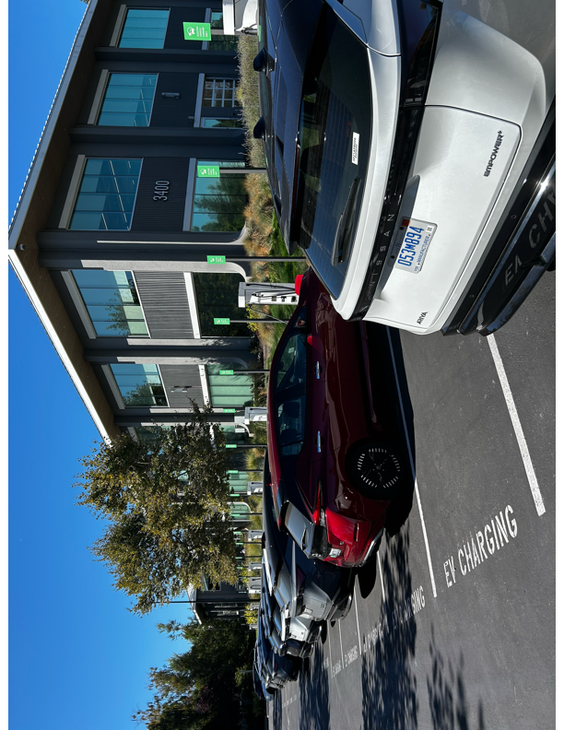
V2B Testbed: Nissan Advanced Technical Center – Silicon Valley
18 / 26
THE TESTBED
Bidirectional Chargers
Commercial building
Bidirectional EVs

Slide 19
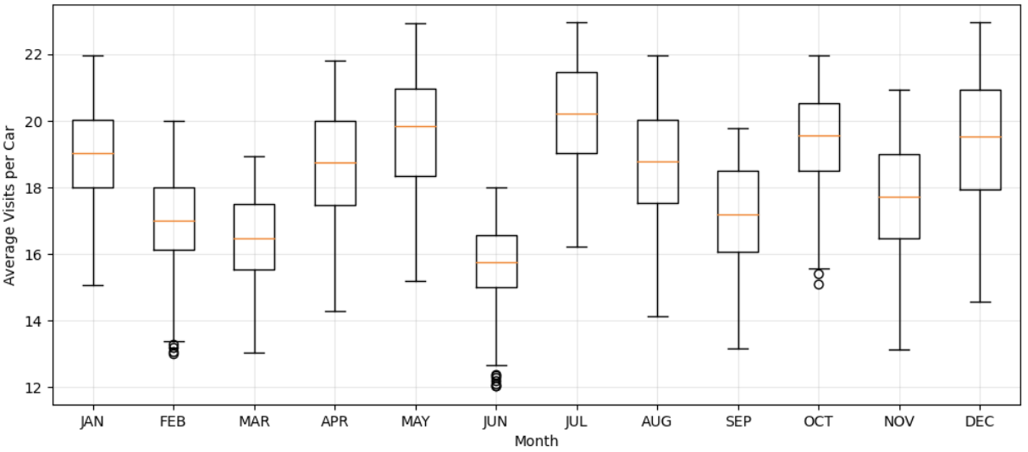
19 / 26
THE DATA
The same people arrive every day.
Anonymized commuter data from Nissan's Santa Clara office. A sharp morning arrival peak, and a median of 15 visits per vehicle, every month.
Arrival time distribution
Monthly visit frequency per vehicle
discrete · binned by hour · all vehicles · 2024
discrete · one point per month · median & mean · 2024
Notes:
But in a real office building, the same fifteen or twenty employees show up every single day. Look at the arrival-time histogram — there's a sharp morning peak. The average car visits fifteen to twenty times per month. These aren't strangers; they're regulars. That persistence means the SoC you leave a car at on Tuesday evening is the SoC that car arrives with on Wednesday morning — minus whatever they used driving home.

Slide 20
20 / 26
EVALUATION
A full year of real building load from Santa Clara, California.
Monthly building load profile, 2024
kW · 15-min resolution
15
Persistent users · Bidirectional chargers · 20 kW max
$0.18 / kWh
Peak time-of-use · 6 AM – 10 PM
$11.67 / kW
Demand charge during peak hours (6AM -10PM)
30 x 12 test samples
Stochastic monthly scenarios
Notes:
To close: persistence is a structural feature of real office EV fleets, and ignoring it costs money. A neuro-symbolic controller — short-horizon MILP with a learned long-horizon terminal cost — gets you near-oracle performance while respecting every user's charging requirement, and it scales to larger fleets within the fifteen-minute control window. I'd love to take your questions.

Slide 21
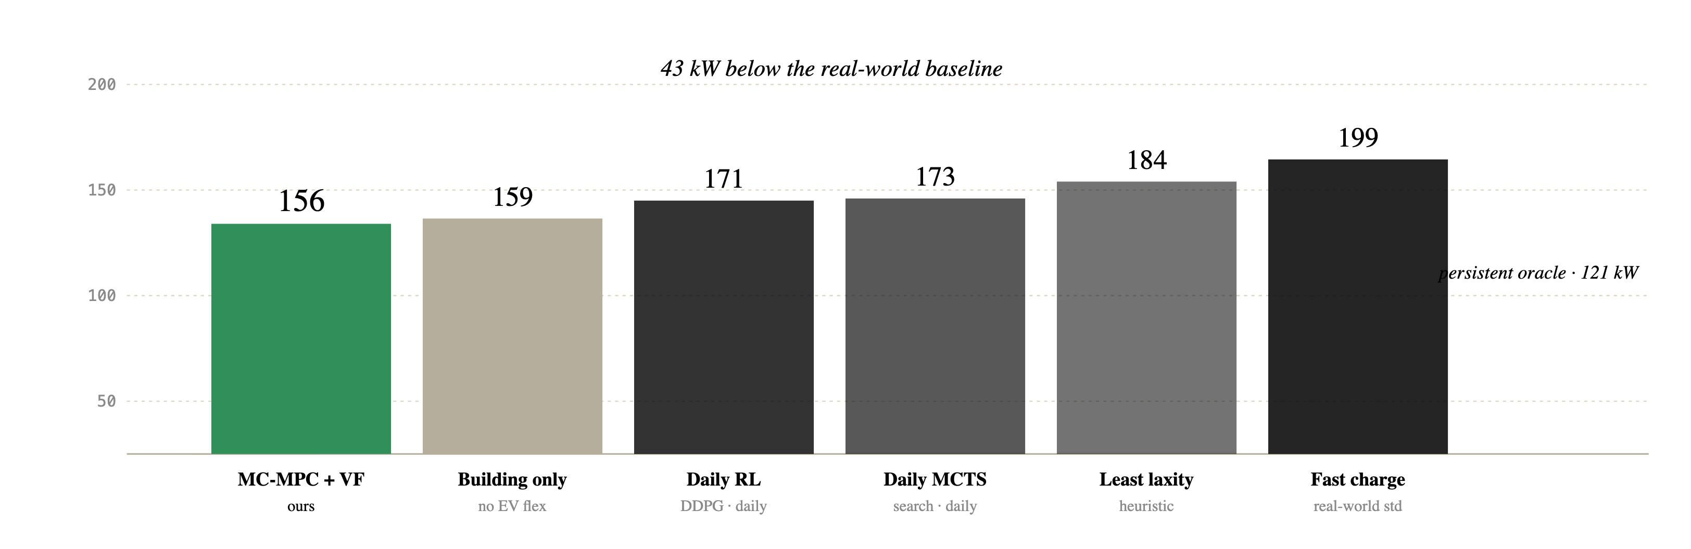
21 / 26
Peak Shaving
Mean monthly peak power (demand charge equivalent), averaged over 12 months (in kW)
lower is better
Notes:
Thank you. Happy to take questions.

Slide 22
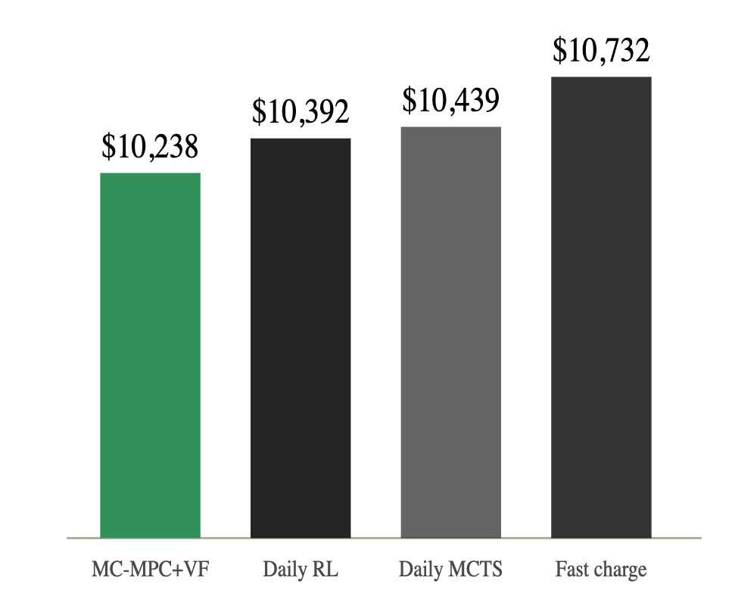
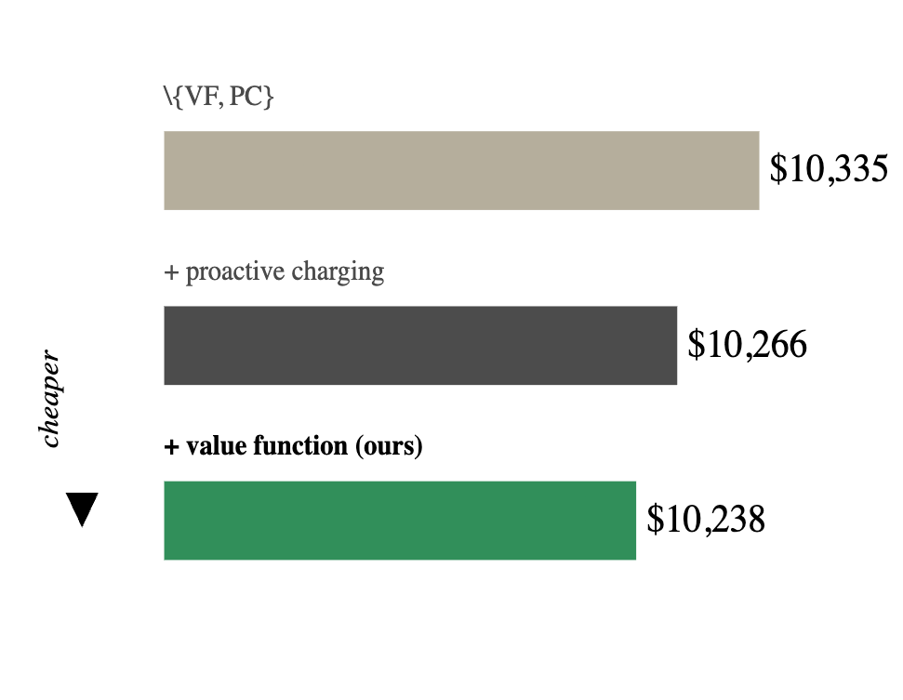
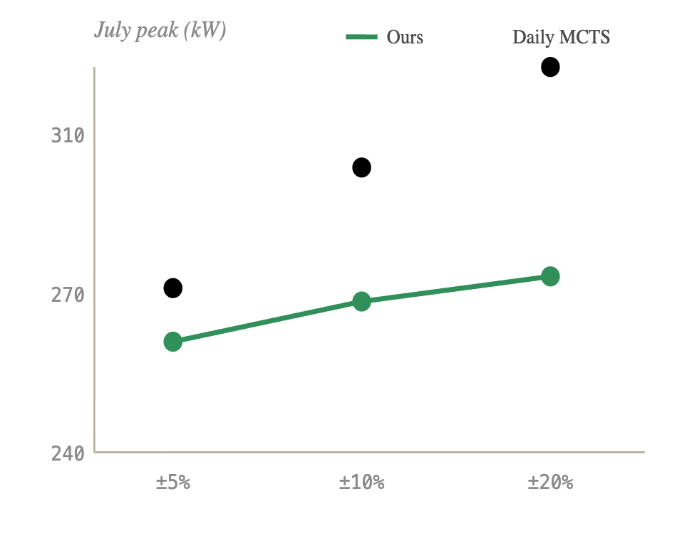
22 / 26
Cost, Ablations, and Robustness
MONTHLY BILL
ABLATION
ROBUSTNESS
Lowest mean bill among all online controllers.
The VF is the dominant driver. Proactive charging helps.
Graceful under upto 4× nominal forecast noise.
MC-MPC base
+ proactive charging
Power (kW)
+ value function (VF)
Full year, mean bill. VF carries long-horizon strategy; PC builds the buffer.
Load-forecast noise stressed to ±20%.
Ours drifts ~16 kW; MCTS drifts 50kW+.
All user SoC requirements met, every scenario.

Slide 23
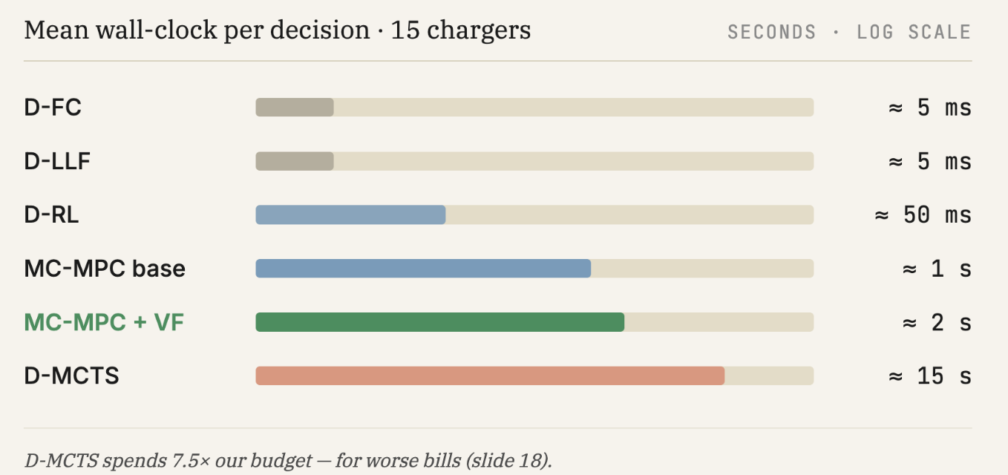
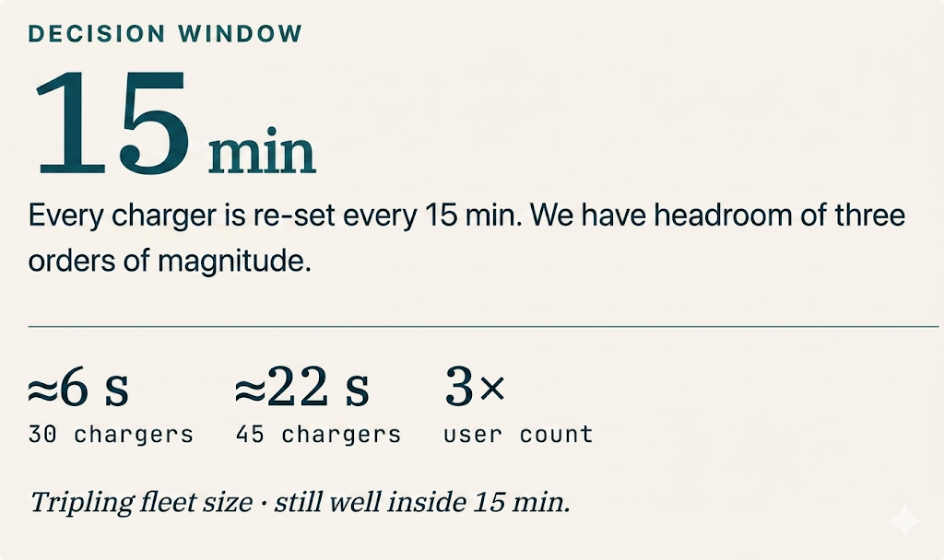
23 / 26
REAL-TIME FEASIBILITY
Time to decision
Mean wall-clock per decision · 15 chargers
SECONDS · LOG SCALE
D-FC
≈ 5 ms
D-LLF
≈ 5 ms
D-RL
≈ 50 ms
≈ 1 s
.
MC-MPC base
2
MC-MPC + VF
≈ 2 s
D-MCTS
≈ 15 s
.
D-MCTS spends 7.5× our budget — for worse bills (slide 18).
Notes:
A few more results worth mentioning. The dollar savings track the peak-shaving — lowest monthly bill among all online controllers. The ablation confirms that both the value function and the proactive-charging term contribute, with the VF being the dominant factor. And under load-forecast noise of plus or minus twenty percent — four times the nominal uncertainty — we only degrade by about seven dollars on the peak-power side, while MCTS degrades by fifty-plus kilowatts. That robustness comes directly from the Monte Carlo scenario sampling.

Slide 24
24 / 26
CAVEATS
MC-MPC + VF with persistence beats other approaches, with caveats.
UNKNOWN USER
USER FREQUENCY
SUDDEN DISRUPTIONS
A stranger offers no usage history.
Persistence improves with repeat visits.
User leaves, charger breaks, building load spikes.
No prior operator visits means no learned persistence signal, Û, to leverage.
Fall back to MC-MPC base with conservative assumptions.
MPC+VF still ≥ MPC base once even one return visit is observed.
More operator history → stronger Û signal → better performance.
Infrequent users provide weak signal; the system degrades toward MC-MPC base.
Abrupt mid-session events break the learned persistence pattern
MPC+RL still outperforms MPC-only even under disruption. The MILP layer provides a hard safety floor.
Notes:
MPC + RL is more robust than pure RL/MCTS. No unknown user information, and users use the operator multiple times. If a stranger comes, we need to use a very conservative assumption.
Takeaway: Persistence relies heavily on user behvaior –the more the better. The less its, it boes back to the MC-MPC base. More nfo we know – better leverage better performance. User suddenly leaves, charger broken, building sddenly spikes – limitation,s but MPC+ RL still better than MPC only.

Slide 25
25 / 26
FUTURE SCOPE
Improving Persistence with User flexibility & Demand Response
LEVERAGING THE COMPLETE PIPELINE
OPEN QUESTIONS
P-V2B + CONSENT + Demand Response (DR) Control
Where we want to explore next.
The works combined: P-V2B generalises across sites, CONSENT enforces per-user privacy, DR opens more scope for operator incentives, all with online decisions.
Where is this useful?
Commercial V2B deployment partner
Fleet operators & smart-parking platforms
Path from simulation to live infrastructure
Proprietary industry data: Working on planned release of open benchmark & dataset
Multi-site VF: shared structure across Nissan campuses
Online VF updates: react to seasonal users without retraining
Mixed fleets: P-V2B for the persistent core, RL for the transient tail
Co-optimization with on-site solar & stationary storage

Slide 26

26 / 26
Thank you.
Questions & Comments?
rishav.sen@vanderbilt.edu
Thanks to our collaborators at Nissan Advanced Technology Center - Silicon Valley.
Work supported in part by the National Science Foundation.
Paper Link

Slide 27
V2B RESEARCH PROGRESS
Deterministic → Uncertainty Aware Systems
Q
Mixed Linear Programming (MILP)
MCTS: Monte-Carlo Tree Search¹
Reinforcement Learning System²
Pros:
Optimal solution
Cons:
Poor at handling uncertainty
Needs complete information (Oracle)
Fast convergence (for regular problem size)
Pros:
Fully online, anytime, and robust
Robust to environmental changes
Cons:
Slow, mainly due to the number of iterations
Large action space is a major challenge
Pros:
Fast
Effectively address complex input features
Long-Term Optimization
Cons:
Challenges with large and continuous action spaces.
Limited robustness to unseen conditions.
[1] Sen et. al, Online Decision-Making Under Uncertainty for Vehicle-to-Building Systems, ACM/IEEE ICCPS 2025
[2] Liu et. al, Reinforcement Learning-based Approach for Vehicle-to-Building Charging with Heterogeneous Agents and Long Term Rewards, AAMAS 2025

Slide 28
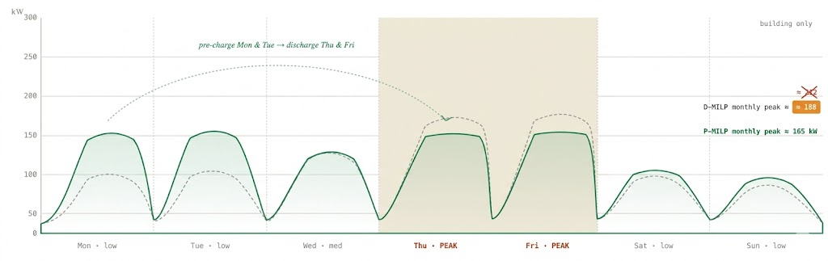
07 / 28
THE OPPORTUNITY
Same fleet, same building. Now with persistence.
Example: Effect of Persistence in V2B (oracle solutions)
D-MILP
daily oracle
P-MILP
monthly oracle
building load + V2B controller output · 15-min · kW
Pre-charge more on Monday & Tuesday $−>$ Discharge heavily on Thursday & Friday
D-MILP peak = 188kW
P-MILP peak = 165kW
Combined Power use (kW)
Gap: 23kW
Notes:
So our answer is a neuro-symbolic hybrid. The symbolic half is a Monte Carlo Model Predictive Controller — it looks ahead to the end of the day, enforces all the physical and user constraints, and handles uncertainty by averaging over sampled futures. The neural half is a learned value function that estimates the cost-to-go from the end of the day all the way to the end of the billing cycle. The MPC gets the short-horizon feasibility right; the value function supplies the long-horizon strategy. They talk to each other through a terminal cost in the MPC objective.

Slide 29
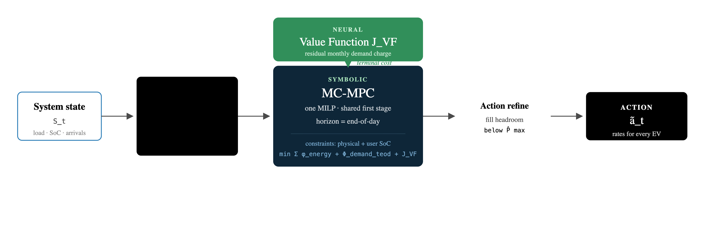
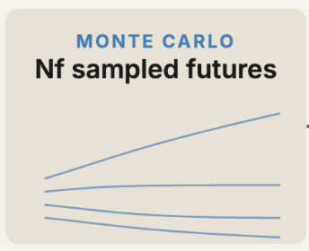
11 / 28
THE APPROACH
MC-MPC for feasibility. A learned value function for foresight.
Short-horizon MILP enforces every physical and user constraint. The neural VF plugs in as a terminal cost, carrying month-long strategy into a one-day optimization.
Notes:
Let's unpack the MPC side. At every fifteen-minute control step, we sample ten possible futures for the rest of the day — different arrival patterns, different load realizations. We then solve one MILP that has to commit to a single first-stage action good across all ten scenarios. This is sample average approximation, and it gives us robustness against both arrival noise and load-forecast error. Constraints in this MILP guarantee every user gets the charge they asked for before they leave. Nobody's cheated out of their commute.

Slide 30
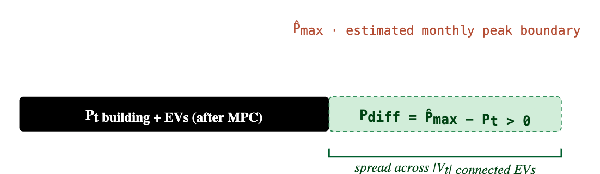
17b / 26
TWO EXTRA INGREDIENTS · THE BUFFER AND THE HEADROOM
Build a buffer in the objective. Spend any leftover headroom after solving.
01 · IN THE MPC OBJECTIVE
step 1 · proactive charging
min 𝔼_{F} [ Σ φ^{energy} + Φ^{demand}_{teod} − w_{pc}·Σ_{v,k} r^{v,k}_{j}·Δt + J_{VF}(S_{teod}) ]
Plant a buffer the VF will spend later.
A small reward for charging beyond what the user asked for — pays for itself in a future peak.
Without a nudge, the MPC has no reason to put more into a car than the user asked for — and the cross-day buffer never forms. The −w_{pc} ·Σ r·Δt term rewards slight overcharging during low-cost windows.
GRID SEARCH
BEST
w_{pc} ∈ [0, 5] · step 0.2
w_{pc} = 0.8
Kept small on purpose — enough to seed persistence, never enough to create a new peak alone.
02 · AFTER THE MILP SOLVES
step 2 · action refinement
Don't leave free headroom on the table.
MC-MPC is conservative — one action shared across ten futures. The realized load is often lower than the worst sample, leaving room under P̂_{max} that it didn't use.
A fast heuristic spreads any positive P_{diff} evenly across connected EVs, capped by charger and SoC limits. Free efficiency, by construction no new peak.
r^{v,k}_{t} ← min( r^{v,k}_{t} + P_{diff} / |V_{t}|, r_{max} ) if it doesn't violate the user's SoC cap

Slide 31
22 / 28
TAKEAWAYS
Persistence is structural. Treat it as a control opportunity, not noise.
NEAR-ORACLE
USER REQUESTS FULFILLED
REAL-TIME SCALABLE
<5
100 %
≈2 s
%
gap
Lowest mean monthly bill among all online controllers, across a full year of real building load.
Every user meets their required state-of-charge at departure, every scenario. MILP-enforced, not reward-tuned.
Per decision at 15 chargers; 22 s at 45 chargers: well within the 15-minute control window.
Notes:
Show how we are combining FSL+CONSENT+online decisions. How does this work combined? Where does this go?
- Resilio
Mobility
Real deployment?
This is prop. industry data. Working on open dataset & benchmark (similar to MoveOD) - open source that
Cheekily talk about Postdoc employment

Slide 32
10 / 26
WHAT MC-MPC ACTUALLY SAMPLES FROM
Four conditional models for Monte Carlo sampling.
KEY ASSUMPTION
Arrivals are exogenous. We presample once per scenario; the MILP only sets charging rates.
Validated with the building operator: schedules don't depend on building load or prior charging.
AT CAR ARRIVAL
EV behavior · component models
22 MO. NISSAN TELEMETRY
DRAW 1 · ZINB
RANDOM VARIABLE
MODEL FAMILY
CONDITIONED ON
arrival times of future cars
Arrivals / 15 min
Zero-inflated negative binomial
Date · DoW (day of week) · Hour
↓
DRAW 2 · BETA
Arrival SoC of future cars
Arrival SoC
Beta regression
DoW · cyclical time
↓
Departure SoC
Beta regression
Arrival SoC · DoW · time
DRAW 3 · BETA | ARRIVAL SOC
Expected departure SoC of future cars (target the controller must hit)
Stay duration
Weibull survival
DoW · arrival time
↓
DRAW 4 · WEIBULL
Expected stay duration of future cars (when the car leaves)
Building load
Realized load + 5% zero-mean Gaussian noise
+
BUILDING · REALIZED + NOISE
15-min load trajectory

Slide 33
BACKUP — Q&A B1 / B6
How sensitive is performance to PWL grid resolution?
20 grid points/dim = operating point: MAE ≈ 0.030–0.034, runtime ~2 s
Coarser grids → MAE degrades
Finer grids → runtime exceeds 15-min control interval
Full tradeoff table: paper Appendix
Notes:
Triggered by 'why 20 grid points?' [partial — exact full tradeoff table is in paper Appendix].

Slide 34
BACKUP — Q&A B2 / B6
How is the VF trained?
Stage 1 — Offline pre-training
Synthetic monthly scenarios → P-MILP oracle → (VFInput(S_t), Φ_demand,end − Φ_demand,eod) supervised pairs → train [64,64] ReLU MLP
Stage 2 — Online fine-tuning
Bracket MC-MPC behavior with Nominal MPC (mean forecast) + Robust MPC (95th-percentile worst-case); roll out to month-end, store realized residual demand charge in replay buffer, regress JVF toward it. Iterate.
Notes:
Bracketing trick (Nominal + Robust MPC) avoids the cost of training on full MC-MPC rollouts. Replay buffer is per-month; one VF per month worked best in our sweep.

Slide 35
BACKUP — Q&A B4 / B6
Why not month-long stochastic MPC or persistence-aware RL/MCTS?
1. Month-long stochastic MPC: 30 days × 96 timesteps × N_f scenarios × continuous action → MILP intractable; loses real-time guarantees
2. Persistence-aware RL: 2880-step episode, dominant demand-charge signal at terminal step → severe credit-assignment + exploration problems
3. Persistence-aware MCTS: continuous action × month-long horizon → branching explosion
Our hybrid sidesteps all three.
Notes:
Defend by emphasizing credit-assignment in monthly-horizon RL: the dominant signal (demand charge) only shows up at month-end, after 2880 timesteps. RL needs millions of episodes to learn that. Our hybrid uses MILP for short horizon and pre-trained VF for long horizon, sidestepping the credit-assignment problem entirely.

Slide 36
BACKUP — Q&A B5 / B6
What hyperparameters did you use?
Hyperparameter | Range / Best
F (sample size) | 5–30 (step 5) · best = 10
w_pc (proactive) | 0–5 (step 0.2) · best = 0.8
VF architectures | [16,16], [32,32], [64,64]
Learning rates | 10⁻³ – 10⁻⁵
Best VF | [64, 64], one per month
PWL grid | 20 points / dim
Action refinement on (~$80/month gain).
Notes:
Grid search across F, w_pc, VF architecture, and learning rate. Per-month VF (one network per calendar month) was a meaningful gain over a single year-round VF — pre-empts hyperparameter brittleness concerns.

Slide 37
BACKUP — Q&A B6 / B6
What about unexpected user dropout?
Dropout (Jul–Sep) | MC-MPC+VF (ours) | D-RL
5% | $13,382 ± 1,054 | $13,479 ± 1,044
10% | $13,363 ± 1,052 | $13,428 ± 1,044
Mechanism: when a user fails to arrive, the MPC layer observes zero availability and re-optimizes over the remaining fleet → immediate feasibility correction without re-training the VF.
Notes:
MPC layer auto-corrects under distribution shift. The VF was trained on full-attendance assumptions, so it's wrong when users drop out — but the MPC layer absorbs the correction online by re-optimizing over the realized fleet. Cleanest illustration of why the symbolic layer matters under uncertainty.

Slide 38
Our V2B Research Journey
★ = Nominated for Best Paper (Top 5)
2024
2025
2025
2026
2026
SmartComp
ICCPS
AAMAS★
ICCPS
AAMAS (accepted)
Simulation → Online Control → Learning → Persistence → Human-in-the-Loop
OPTIMUS
DG-MCTS
RL-V2B
P-V2B
CONSENT
Discrete-Simulation
platform
Online
Decision-making
Reinforcement
Learning with sparse rewards
Neuro-Symbolic
control
User
Negotiation with guarantees

