Slide 1
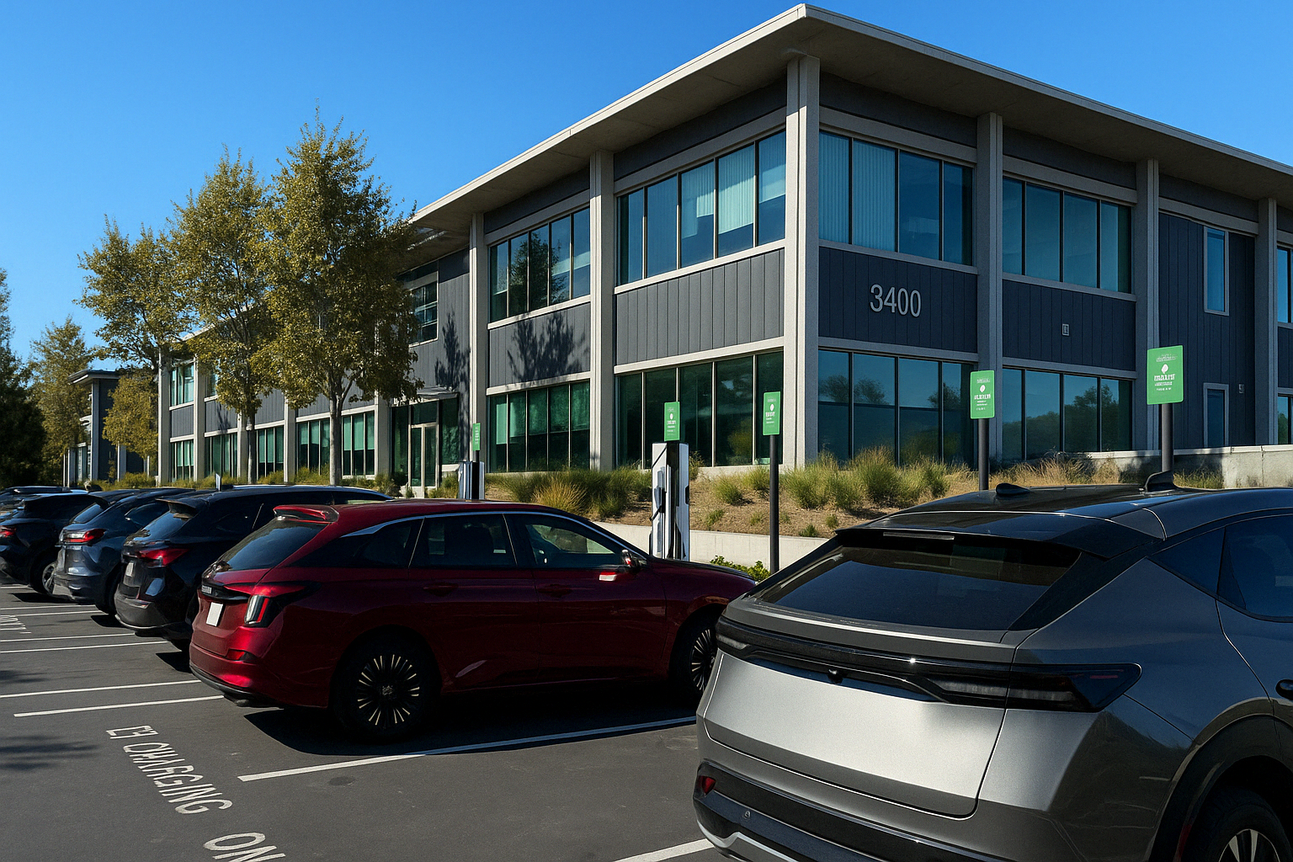
Online Decision-Making
Under Uncertainty for
Vehicle-to-Building Systems
Rishav Sen, Yunuo Zhang, Fangqi Liu, Jose Paolo Talusan, Ava Pettet, Yoshinori Suzue, Ayan Mukhopadhyay, Abhishek Dubey

Slide 2
Outline
V2B problem
Challenges
Problem definition & Modeling
Limitations of Existing Approaches
Our Approach: Domain-knowledge Guided MCTS (DG-MCTS)
Decentralized version (dMCTS)
Experiments & Results

Slide 3




Vehicle-to-Building (V2B) Problem
V2B problem: Manage Energy flow between EVs and smart buildings.
Control Actions: Charge/Discharge EVs plugged into buildings.
Allows: Peak shaving, load shifting, and demand response.
Goal: Minimize building’s electricity cost (energy + demand cost) while meeting EV user needs.
V2B, a CPS problem: Controlling a feedback loop between digital control and physical energy flow.
Electricity cost: $10,000 $9000
From Grid
From EV
Req. SoC
Stay duration
Cur. SoC
Bi-directional
Req. SoC
Stay duration
Cur. SoC
Uni-directional
Notes:
Let’s begin with the Vehicle-to-Building or V2B problem.
EVs can charge or discharge, helping the building manage both energy and demand costs.
The goal is to reduce electricity bills while making sure EV users leave with enough charge.
This bi-directional flexibility enables peak shaving, demand response, and grid services — but also introduces uncertainty and complex decision-making, which we’ll explore next.
This is a classic cyber-physical system — we have digital logic controlling energy decisions, and physical responses through EV batteries and building load.
Takeaway: Establishes V2B as a dynamic, bidirectional energy management problem tightly coupled with CPS logic and user behavior.

Slide 4

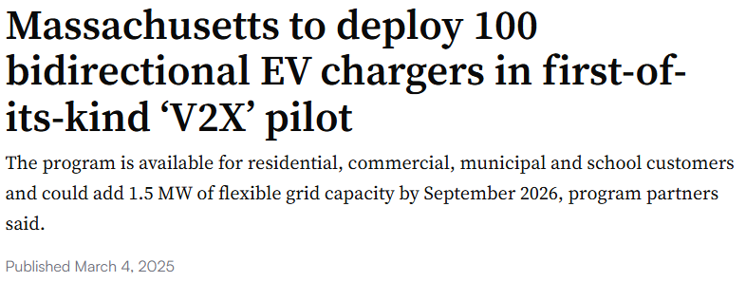

In the News
V2X – Vehicle to Everything; V2B $⊆$ V2X
Notes:
Int hew news about V2B – we see the use of the term V2X which includes V2B, V2G
Nissan has been a leader in the V2B space
Use of V2X is steadily accelerating, with large scale investments ( e.g. Massachusetts) and advancements in V2X technology (Chargepoint)

Slide 5
Why Is V2B Optimization Hard?
Uncertainty
Stochastic EV arrivals
Varying SoC needs (SoC gaps)
User-specified departure windows – not exact departure time
Long planning horizon
Demand charge based on monthly peak power
Varying building loads across a month
Delayed rewards
High-Dimensional Action Space
Multiple EVs, each with different control limits
Combinatorial number of charge/discharge options
Scalability
Number of EVs and chargers varies daily
Support varying EV counts without retraining
Notes:
Once we understand the V2B problem, the real question is: why is it hard to solve?
First, uncertainty dominates—user arrivals, energy needs, and departure times are not known exactly.
Second, this isn’t just a short-horizon control problem. Demand charges are computed monthly, so early mistakes can’t be fixed easily.
Third, the action space is huge—each charger and car adds exponential complexity.
Takeaway: This slide sets up the modeling and algorithmic innovation to follow. It tells the viewer: This is not your average control problem.

Slide 6




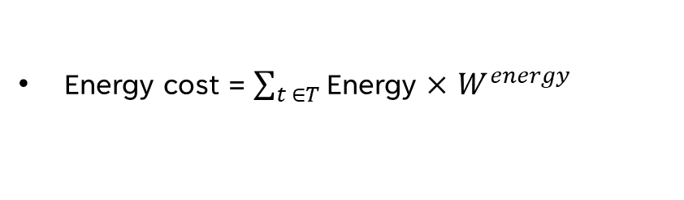

Scope for V2B Optimization
(how smart building operator & users can benefit)
Lower energy cost
No demand cost
Higher energy cost
Demand cost
Off-Peak
Off-Peak
Off-Peak
Off-Peak
Peak
Peak
Peak Building Load
EVs discharging to power building
$$P_{B}^{max}$$
$$P_{B}^{max}$$
Peak value
Area under curve
$$P_{optimized}^{max}$$
Building
Power
Determined over the month
0
$$+$$
0
day
How to optimize?
Charging
Rate
$0.15/kWh (peak)
Energy cost = $\sum_{t ∈T}{\text{Energy}}$ $×$ $W^{energy}$
0
Demand cost = $P_{optimized}^{max}×$ $W^{demand}$
Demand cost = $P_{B}^{max}×$ $W^{demand}$
Discharging to reduce peak power (demand cost)
$10/kW
Charging more in off-peak to lower energy cost
Total Cost = Energy cost + demand cost
6
Notes:
Building’s load - >off-peak & peak pricing ->peak BL
Costs:
Energy cost
Demand cost
Total cost
How to optimize -> show optimal charging actions
Using the charging actions -> BL lowers -> lower peak power
Here you can see the cost split: demand and energy. If we reduce peak consumption, we reduce the demand charge. So the controller must time charging and discharging to shift loads — and that brings us to the formulation.
To solve this problem, we need to reason across time, uncertainty, and constraints.
MDPs provide a natural framework for online, sequential decision-making under uncertainty.
Takeaway: Introduces formal control modeling under uncertainty with online decision-making.

Slide 7

Problem Definition & Modeling
Objective:
  Minimize total electricity cost
  Meet SoC requirements (otherwise, penalized)
Constraints: Handle Input uncertainties
Output: Online charging actions at each timestep for each charger.
Modeled as Markov Decision Process (MDP):
  States: Time, Building load, EV occupancy, SoC needs
  Actions: Heterogeneous charger rates (discrete)
  Rewards: Total electricity cost + missing SoC penalty
Reward calculation
…
Notes:
To solve this problem, we need to reason across time, uncertainty, and constraints. MDPs provide a natural framework for online, sequential decision-making under uncertainty.

Slide 8


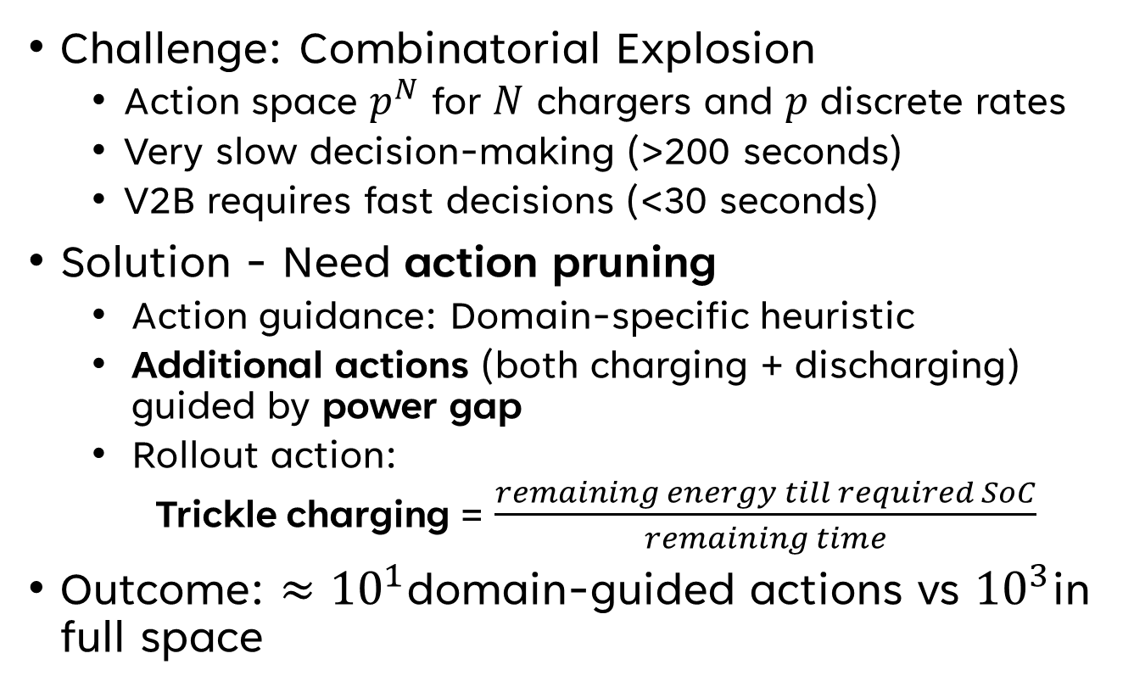
Focusing on the Action Space
Challenge: Combinatorial Explosion
  Action space $p^{N}$ for $N$ chargers and $p$ discrete rates
  Very slow decision-making (>200 seconds)
  V2B requires fast decisions (<30 seconds)
Solution - Need action pruning
  Action guidance: Domain-specific heuristic
  Additional actions (both charging + discharging) guided by power gap
  Rollout action:
  Trickle charging = $\frac{remaining energy till required SoC}{remaining time}$
Outcome: $≈{10}^{1}$domain-guided actions vs ${10}^{3}$in full space
$${\hat{P}}_{max}$$
Power gap
$$P_{max}$$
Notes:
Motivate the combinatorial explosion in action space.
Emphasize that V2B requires fast decisions, so pruning is crucial.
Takeaway: Domain knowledge drastically reduces the action space, making real-time planning feasible.
Next: Having reduced action space, we now show how to handle long horizons and uncertainty.

Slide 9
Existing Approaches
& Limitations
Static (MILP-based) Optimization ^{1,2}
Provides minimum electricity cost under full knowledge
Can use continuous action spaces
Offline, assumes full knowledge – not realistic for dynamic V2B settings
Fails under uncertainty
Heuristics ^{3,4}
Fast execution time
Developing suitable heuristic can be difficult
Myopic - Cannot plan well to mitigate future uncertainty
Reinforcement Learning ^{5,6}
Very fast execution time
Adaptive to bounded uncertainty
Sample inefficient
Tricky credit assignment for long horizons (delayed rewards)
Brittle to rare events
Notes:
MILP – Mixed Integer Linear Program – say it full
So far, we saw how to model V2B optimization as a sequential decision problem.
But how do we solve it?
Traditional methods all fall short
MILP assumes perfect foresight
heuristics are too simple
RL suffers from sample inefficiency and struggles with rare or delayed feedback like demand charges.
This motivates an online, adaptive, yet efficient solution, that handles uncertainty and scales

Slide 10
We need an Online, Fast, Robust, Scalable algorithm
To plan online decisions under uncertainty, we use Monte Carlo Tree Search (MCTS)
Tree-based planning algorithm for sequential decision-making.
Iteratively builds a search tree:
  Selection using UCT (Upper Confidence Bound for Trees)
  Expansion of promising nodes
  Simulation using default policy.
  Backpropagation of reward estimates.
We extend vanilla MCTS with Domain-Guided MCTS (DG-MCTS):
  Domain-guided actions prune irrelevant branches
  Temporal decomposition aligns short-term actions with long-term peak reduction.
root
Back-
propagate
Rewards
Simulate
…
Notes:
MCTS - get better decisions the more you simulate — "anytime" property
This is our core solution slide. It explains how we solve the problem using MCTS
The algorithm builds and refines a tree at each decision point — not just one plan, but constantly re-planning
This gives us robustness to uncertainty

Slide 11
Temporal Decomposition + Root Parallelization
Temporal Decomposition:
  Predict peak demand for constraint guidance
    From MILP (optimal) solution (99% confidence bound)
  Month-long horizon are decomposed into daily episodes
    Preserves monthly demand structure by using the predicted peak
Root parallelization:
  Sample multiple possible episodes
  Build separate MCTS trees
  Aggregate root action Q-values across trees
Notes:
Given that we have to solve for long horizon problems, we need to decompose the problem temporally to keep it tractable
To make computation faster, we parallelize the solution using RP

Slide 12





Domain-Guided MCTS (DG-MCTS)
$${\hat{P}}_{max}$$
1. Sample EV trajectories and building loads (exploration samples)
2. Estimate peak demand threshold via MILP over samples.
3. Generate feasible action set using domain knowledge.
4. MCTS rollouts with default trickle charging policy.
5. Select best action from averaged root-parallel trees.
Features of DG-MCTS:
Handles Uncertainty via sampled exploration and rollout simulations
Plans Non-Myopically to manage long billing horizons
Reduces Action Space complexity by leveraging Domain-specific heuristics
Scales Efficiently via decentralized variants and tree parallelization
Notes:
Step 1: Links to stochastic EV arrivals (uncertainty)
Step 2: Reuses MILP for offline peak estimation
Step 3: Comes from the action space reduction slide
Step 4–5: Comes from the “how MCTS works” explanation

Slide 13
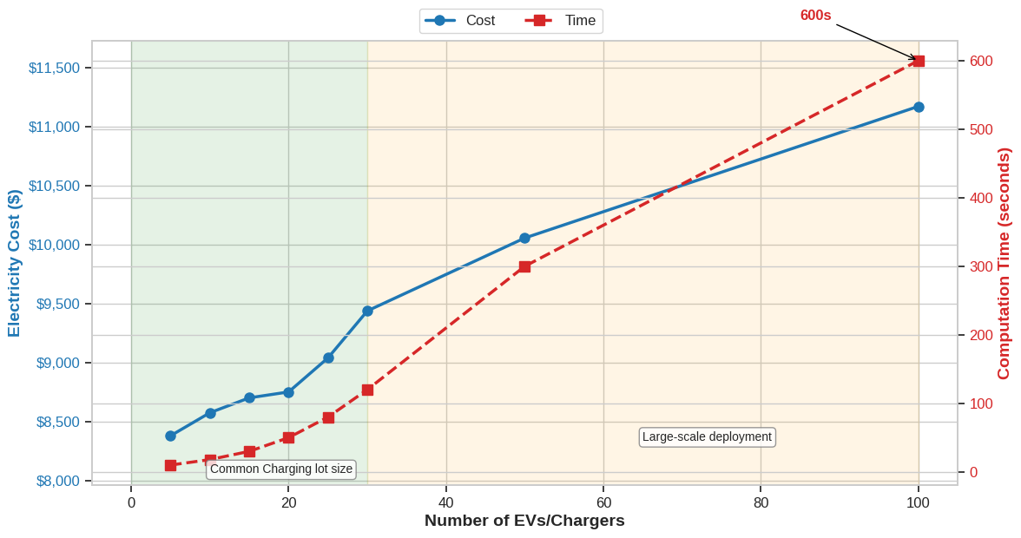
DG-MCTS: Performance vs Time
As the number of EVs/chargers increases, both cost and computation time increase

Slide 14
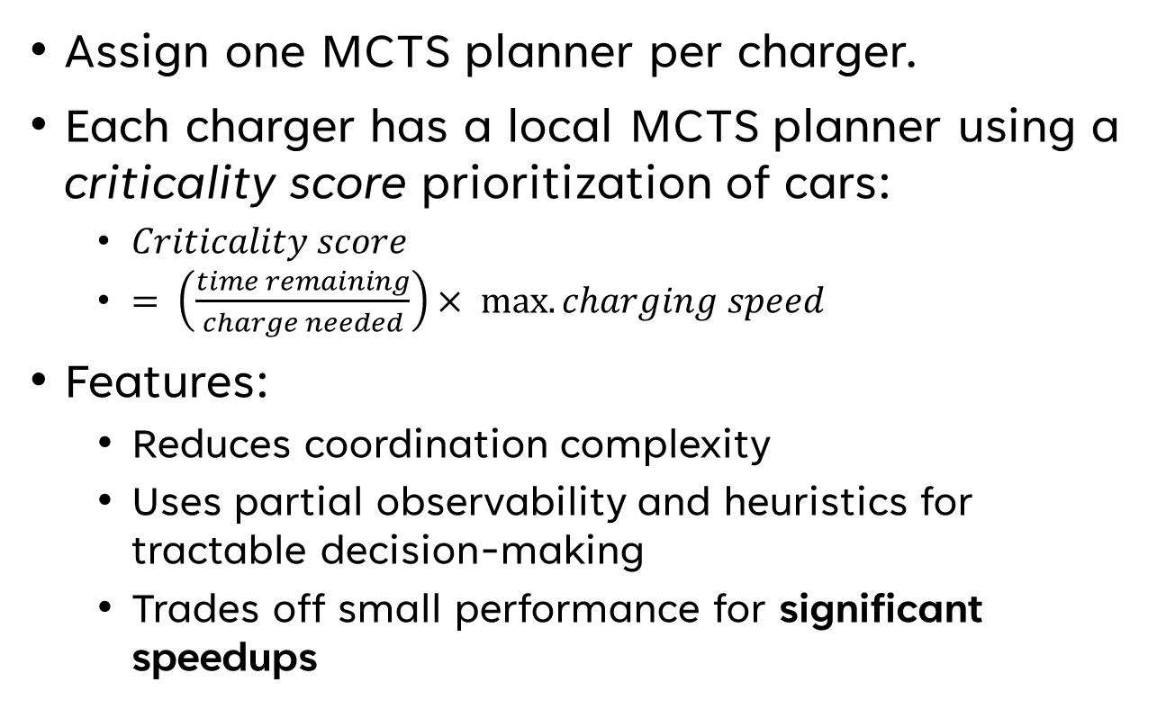
Decentralized DG-MCTS (dMCTS)
Assign one MCTS planner per charger.
Each charger has a local MCTS planner using a criticality score prioritization of cars:
  $Criticality score$
  $= \left(\frac{time remaining}{charge needed}\right)× max. charging speed$
Features:
  Reduces coordination complexity
  Uses partial observability and heuristics for tractable decision-making
  Trades off small performance for significant speedups
Notes:
DG-MCTS is the primary approach.
D-mcts : Mention that it will be present in the paper – it is primarily important if scale up and speed are paramount

Slide 15
Experimental Setup
Data Source: EV behavior is Nissan Advanced Technology Center in Santa Clara
  - EV departures are user-provided windows (adds more uncertainty)
Dataset: 8 months of data (May 2023 – Dec 2023)
Chargers: 15 chargers
  10 uni-directional [0, 20kW]
  5 bi-directional [-20kW, 20kW]
Electricity rate:
Metrics:
  Total cost (Peak shaving achieved)
Off-peak ($/kWh) | Peak ($/kWh) | Demand charge ($/kW)
$$0.11$$ | $$0.14$$ | $$9.62$$

Slide 16
Baselines Compared
MaxCharge: Fast charge all EVs completely
  current real-world charging policy
ReqCharge: Fast charge EVs to required SoC.
LLF (Least Laxity First): Charges EVs based on least time-to-deadline.
EDF (Early-deadline-first): Strictly orders EVs by nearest departure time.
RL (DDPG): Learned policy with MILP-guided pre-training.
Domain-Guidance for DG-MCTS uses LLF

Slide 17
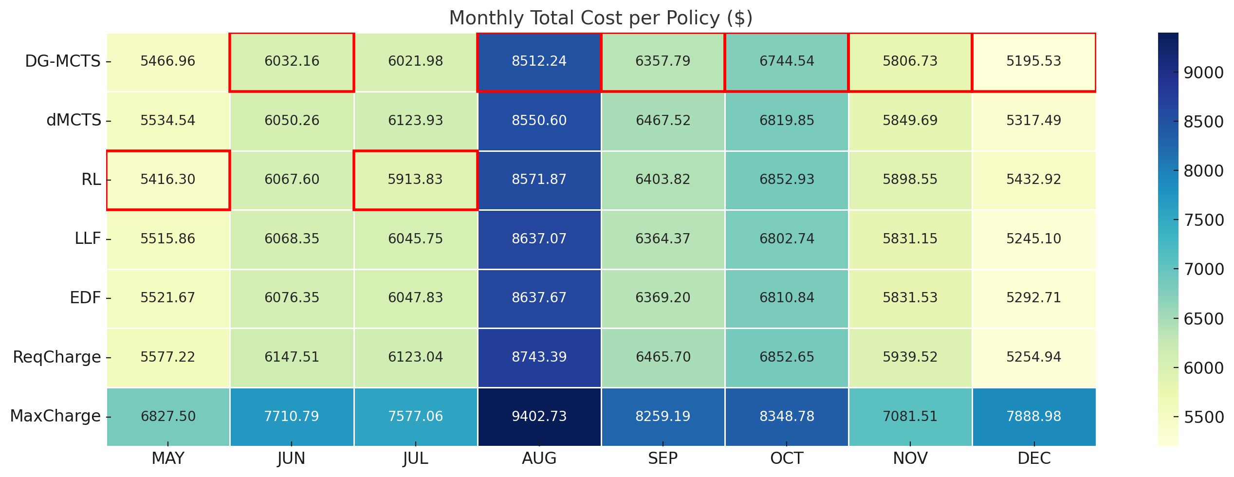

Results: Total Cost
DG-MCTS lowest in 6 of 8 months (~20% cheaper than MaxCharge)
Outperforms RL in 6 months; RL misses many SoC targets
dMCTS slightly worse than DG-MCTS but $\sim$2x faster
Notes:
DG-MCTS is good but could be faster – add a plot between speeds of DG-mCTS and dmcts

Slide 18
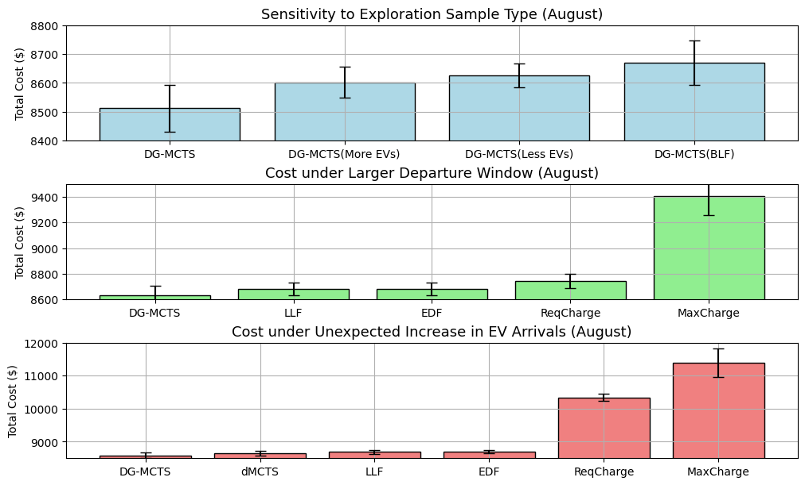
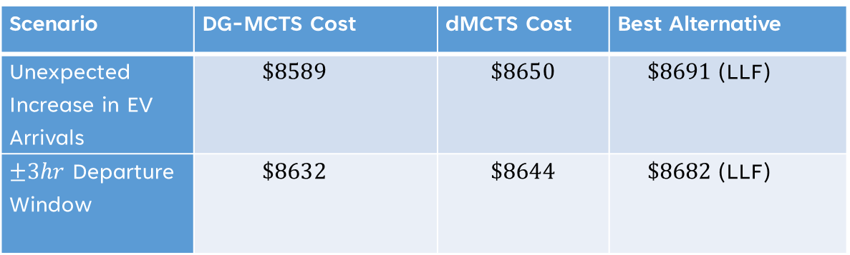

Results: Sensitivity & Robustness
DG-MCTS performance degrades as fluctuations increase
($±$10% Building load fluctuation)
Scenario | DG-MCTS Cost | dMCTS Cost | Best Alternative
Unexpected Increase in EV Arrivals | $$\$8589$$ | $$\$8650$$ | $\$8691$(LLF)
$±3hr$ Departure Window | $$\$8632$$ | $$\$8644$$ | $\$8682$(LLF)
Arrival uncertainty ↑ → DG-MCTS adapts better than RL & heuristics
Departure window ↑ → DG-MCTS stays optimal (lowest cost)
DG-MCTS remains reliable under realistic uncertainties in building systems.
dMCTS scales better than the alternative policies
Notes:
DG-MCTS: Comparable to LLF, better than RL
Robustness & Sensitivity Tests:

Slide 19
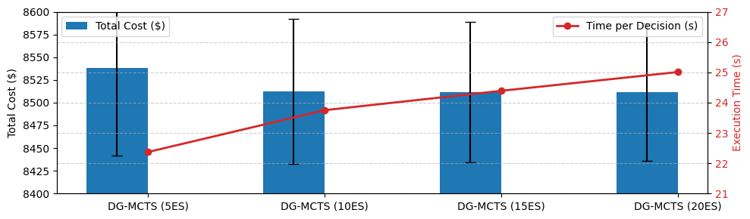



Results: Sensitivity & Ablations
Changing Exploration Samples:
Ablations:
  DG-MCTS with 10 exploration samples provides a balanced tradeoff in total cost and time per decision
$${\hat{P}}_{max}$$
heuristic
vs
No peak power estimate
major cost increase
No heuristic action pruning
search time increases exponentially
Using Piecewise charging profile
shows no significant difference

Slide 20
Contributions & Takeaways
Novel Formulation: V2B as MDP with realistic constraints.
DG-MCTS:
  Enables Robust, near-optimal & online planning under uncertainty
  Domain-guided action generation is key to tractable, effective search
dMCTS: Scalable variant for multi-agent settings.
Validation: Real-world data, real constraints, promising results.

Slide 21
Generalizability
Key contributions of DG-MCTS:
  Handling uncertainty
  Planning under long horizons
  Scalable action search
Where else can DG-MCTS help?
  Real-time vehicle dispatch (emergency response, fleet management)
  Smart devices under price/renewable forecasts
  Distributed Data Center Load Balancing
Modular design: Swap-in domain heuristics & rollout strategies
Notes:
By leveraging domain-specific heuristics over naïve Greedy policies to guide MCTS search

Slide 22
References
[1] Dukpa, Andu, and Boguslaw Butrylo. "MILP-based profit maximization of electric vehicle charging station based on solar and EV arrival forecasts.
[2] Franco, John F., Marcos J. Rider, and Rubén Romero. "A MILP model for optimal charging coordination of storage devices and electric vehicles considering V2G technology."
[3] Nakahira, Yorie, et al. "Smoothed least-laxity-first algorithm for EV charging.
[4] Cao, Yue, et al. "A decentralized deadline-driven electric vehicle charging recommendation."
[5] Jamjuntr, Pitchaya, Chanchai Techawatcharapaikul, and Pannee Suanpang. "Optimizing Vehicle-to-Vehicle (V2V) Charging in Electric Vehicles by Adaptive Q-learning Implication for Smart Tourism."
[6] Yavuz, Mete, and Ömer Cihan Kivanç. "Optimization of a cluster-based energy management system using deep reinforcement learning without affecting Prosumer Comfort: V2X technologies and peer-to-peer energy trading."

Slide 23
Thank You!
Acknowledgments: Nissan Advanced Technology Center, NSF Chameleon Testbed
Contact: rishav.sen@vanderbilt.edu | rishavsen1.github.io
Questions?

Slide 24
Problem Definition
Objective:
  Minimize total electricity cost
  Meet charging requirements (penalized on unfulfilled SoC requirement)
Input uncertainties:
  EV arrival time
  EV departure time window (not the exact departure time)
  State of charge (SoC) on arrival
  State of charge (SoC) required on departure
  Building load forecasts
Output: Online charging actions at each timestep for each charger
Notes:
Diagram added in previous slides

Slide 25
Domain-Guided MCTS (DG-MCTS)
Model problem as Markov Decision Process (MDP):
  States: Time, Building load, EV occupancy, SoC
  Actions: Charging rate per charger
  Rewards: Total electricity cost (lower is better)
Reward calculation
…
Notes:
The reward is based on total cost: energy, demand charge, and SoC penalties.
Now let’s talk about the key features of DG-MCTS.
Handles Uncertainty:
We simulate many plausible futures using exploration samples, making the algorithm robust to randomness in departures and load.
Plans Non-Myopically:
Unlike greedy heuristics, MCTS plans across timesteps, allowing it to foresee peak loads and avoid future penalties.
Uses Domain Heuristics to Reduce Action Space:
Rather than search over all charging combinations, we use insights like Least Laxity First (LLF) to guide feasible and meaningful decisions.
Scales Efficiently:
Through decentralization and root parallelization, we make the method tractable even with many EVs and chargers.

Slide 26
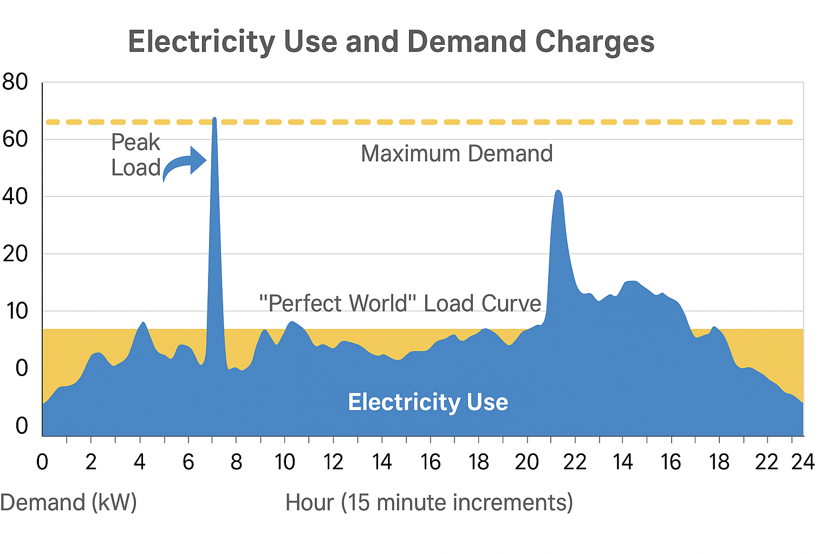



Scope for V2B optimization
Impacts of V2B:
Peak Shaving
Energy Resilience:
EVs serve as power storage units and helping stabilize power consumption from the grid.
Energy Sources
From Grid
From EV
Economic Savings:
EVs lower electricity bills by reducing demand charges during peak times.
Image Source: pluginamerica.org
Notes:
An introduction to the V2B charging problem
Peak load: A building’s peak load is the maximum instantaneous power drawn during a billing period
Energy Resilience: Example, during Hurricane Helene, where EVs powered essential appliances in Charlotte, NC.

Slide 27
Experimental Setup
Data Source: EV behavior is Nissan Advanced Technology Center in Santa Clara
  - EV departures are user-provided windows (adds more uncertainty)
Dataset: 8 months of data (May 2023 – Dec 2023)
Chargers: 15 chargers
  10 uni-directional [0, 20kW]
  5 bi-directional [-20kW, 20kW]
Electricity rate:
Metrics:
  Total cost
  Peak shaving achieved
  At departure:
    Total Missing SoC (compared to required SoC)
    Count of EVs below required SoC
Off-peak ($/kWh) | Peak ($/kWh) | Demand charge ($/kW)
$$0.11$$ | $$0.14$$ | $$9.62$$

Slide 28
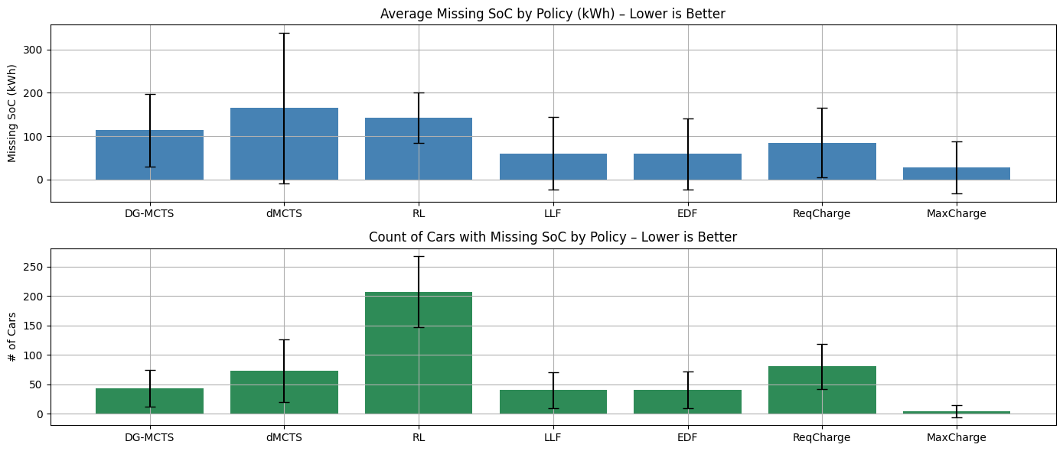
Results: SoC Compliance
DG-MCTS performance:
  Comparable to LLF, better than RL (poor handling of departure time windows)
Notes:
DG-MCTS: Comparable to LLF, better than RL
Robustness & Sensitivity Tests:

Slide 29
Future Directions
Integrate SoC degradation models (battery health).
Multi-building / campus-scale coordination.
Incorporate solar generation & demand response markets.
Apply to other domains: public charging hubs, delivery fleets.

Slide 30
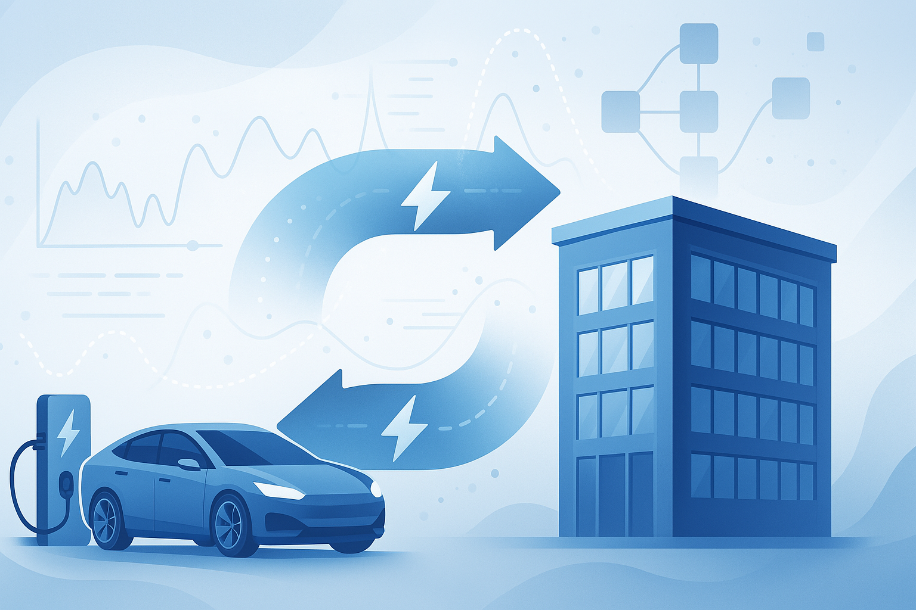
Online Decision-Making
Under Uncertainty for
Vehicle-to-Building Systems
Rishav Sen, Yunuo Zhang, Fangqi Liu, Jose Paolo Talusan, Ava Pettet, Yoshinori Suzue, Ayan Mukhopadhyay, Abhishek Dubey

Slide 31
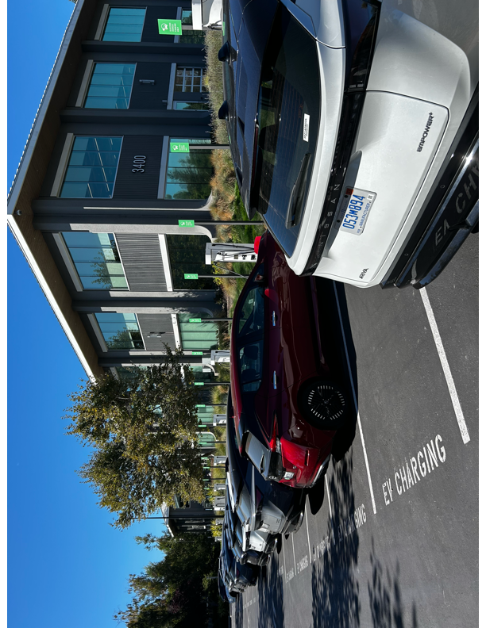
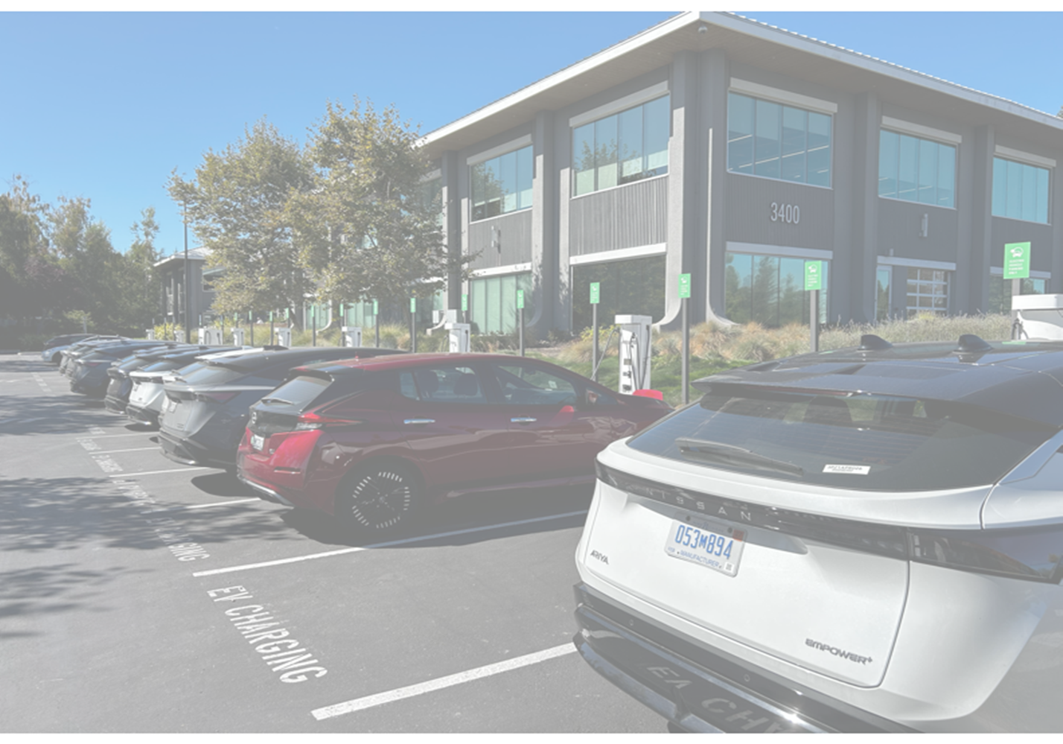
Online Decision-Making
Under Uncertainty for
Vehicle-to-Building Systems
Rishav Sen, Yunuo Zhang, Fangqi Liu, Jose Paolo Talusan, Ava Pettet, Yoshinori Suzue, Ayan Mukhopadhyay, Abhishek Dubey

Slide 32
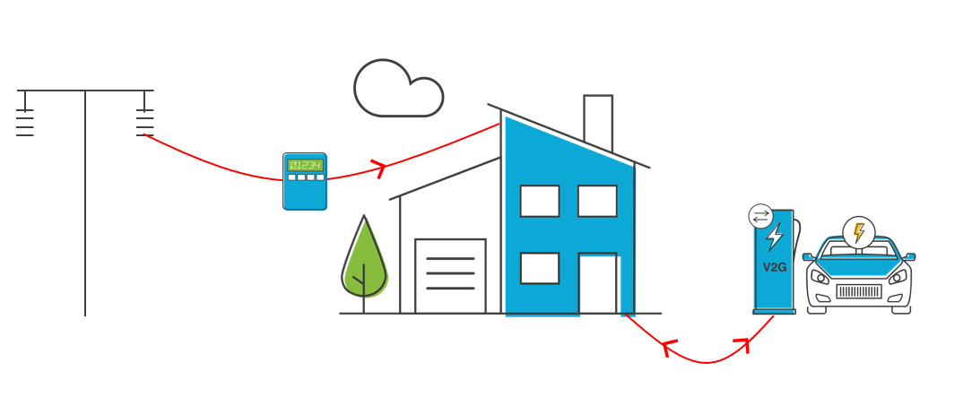
Online Decision-Making Under Uncertainty for Vehicle-to-Building Systems
Rishav Sen, Yunuo Zhang, Fangqi Liu, Jose Paolo Talusan, Ava Pettet, Yoshinori Suzue, Ayan Mukhopadhyay, Abhishek Dubey

Slide 33
Online Decision-Making Under Uncertainty for
Vehicle-to-Building Systems
Rishav Sen, Yunuo Zhang, Fangqi Liu, Jose Paolo Talusan, Ava Pettet, Yoshinori Suzue, Ayan Mukhopadhyay, Abhishek Dubey

Slide 34
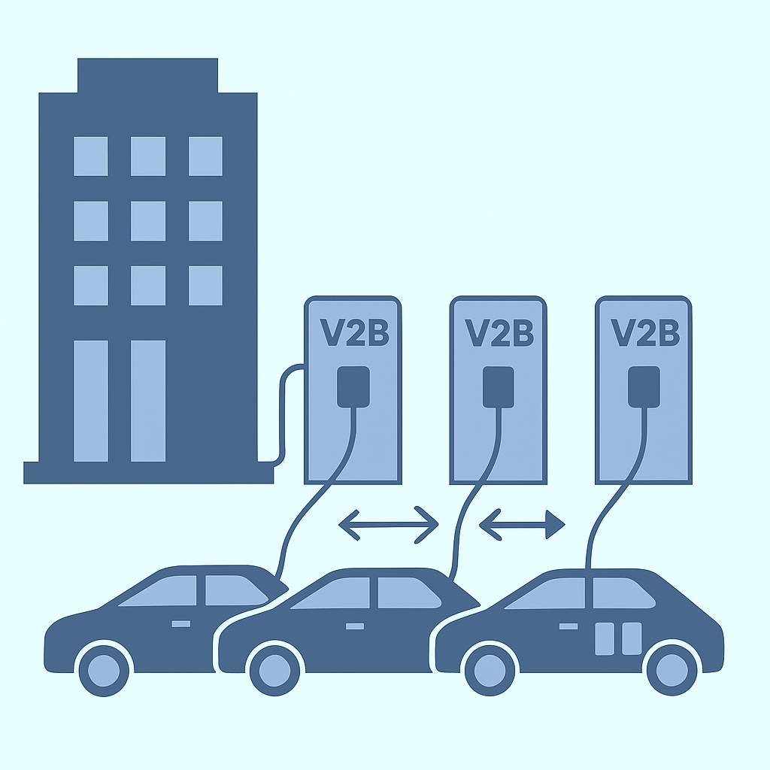
Motivation
EVs are increasingly integrated into smart building energy ecosystems.
Long term effect of power use on the electricity bill (demand charge)
V2B (Vehicle-to-Building) charging enables bidirectional energy exchange.
Online, real-time control is critical due to EV arrival/departure and requirement uncertainty.
Opportunity: Minimize energy + demand costs while meeting EV user requirements.
Notes:
More electric vehicles demanding smart charging solutions
Smart buildings offer workplace charging, but need to manage costs.

Slide 35
Vehicle-to-Building (V2B) Problem: Goals
From Grid
Building
Power
From EV
0
Req. SoC
Stay duration
Cur. SoC
EV Charging
Rate
Car stay duration
Bi-directional
State of Charge (SoC):
The battery level of an EV (%)
Stay duration:
current time and departure time.
0
Uni-directional
Our Focus
V2B Charging Objective: Sequentially determine charging or discharging rates for EVs
35
Notes:
Let’s get into the details of our scenario. The building gets power from the grid, and its energy usage is recorded over time. It has a mix of bidirectional chargers, which can charge and discharge EVs, and unidirectional chargers, which only allow charging.When an EV arrives, it’s assigned to a charger and tells the system two things: its required state of charge or SoC, which is the battery level it needs before its departure, and its departure time.
Our goal is to optimize the charging and discharging rates for all EVs during their stay duration, in a way that minimizes the total electricity bill. The bill has two parts: energy cost for energy consumption for the building and EVs, and demand charges, which depend on the peak power draw in peak hours during the billing period. At the same time, we need to make sure all EV charging needs are met.
-------------------------
Let’s dive into the details of our scenario. The building is powered by the grid, with energy usage recorded over time. It has a mix of bidirectional chargers, which can charge and discharge EVs, and unidirectional chargers, which only allow charging.
When an EV arrives, it’s assigned to a charger and provides two key details: its required state of charge (SoC) before departure and its departure time.
Our goal is to optimize charging and discharging rates for all EVs during their stay, minimizing the total electricity bill, which includes energy costs and demand charges based on peak power during peak hours, while ensuring all EV charging requirements are met.
---------------------------
Traditional energy distribution is centralized
But with the addition of distributed energy resources transferring energy back to the main grid became is an option.
This also provides the opportunity for transferring energy directly between agents.

Slide 36
Handling Action Explosion
Each charger: bidirectional or unidirectional, controlled/uncontrolled
Action space: grows exponentially with charger count
We prune with domain heuristics:
  Least-laxity-first (LLF) based on SoC/time-to-leave
  Trickle rate computation
  Overcharging/discharging options guided by power gap
“Offset” sampling expands around heuristic anchors
Later, we analyze the impact of varying number and quality of exploration samples

Slide 37
Our Approach - DG-MCTS Overview
Propose Domain-Guided Monte Carlo Tree Search (DG-MCTS)
Online method for V2B optimization under uncertainty
Uses domain heuristics to guide tree search:
  Least-Laxity-First charging priority
  Estimated peak power from offline MILP
Root-parallelized trees with sampled episodes
Can be decentralized for scalability (dMCTS)

Slide 38
Monte Carlo Tree Search (MCTS)
Tree-based planning algorithm for sequential decision-making.
Iteratively builds a search tree:
  Selection using UCT.
  Expansion of promising nodes.
  Simulation using default (trickle charge) policy.
  Backpropagation of reward estimates.
Suited for large, uncertain environments.

Slide 39
DG-MCTS Architecture
Steps:
  Sample EV trajectories and building loads.
  Estimate peak demand threshold via MILP over samples.
  Use LLF heuristic to prioritize EVs.
  Generate feasible action set using domain knowledge.
  MCTS rollouts with default trickle charging policy.
  Select best action from averaged root-parallel trees.

Slide 40
Key Results (1/2)
DG-MCTS outperforms all baselines in 6 of 8 months.
Reduces peak demand and SoC penalties simultaneously.
Handles departure uncertainty effectively.
RL struggles with SoC targets (high variance).
Key Metrics (August Example):
Total cost reduction of 12% vs. LLF
Peak shaving improved by 15% over LLF
SoC violations reduced by 30% compared to RL

