Slide 1

AAMAS 2026 · Int'l Conference on Autonomous Agents and Multiagent Systems
CONSENT
A Negotiation Framework for Leveraging User Flexibility in
Vehicle-to-Building (V2B) Charging Under Uncertainty.
Rishav Sen¹ · Fangqi Liu¹ · Jose Paolo Talusan¹ · Ava Pettet² · Yoshinori Suzue² · Mark Bailey² ·
Ayan Mukhopadhyay³ · Abhishek Dubey¹
¹ VANDERBILT UNIVERSITY · ² NISSAN ADVANCED TECHNOLOGY CENTER — SILICON VALLEY (NATC-SV) · ³ WILLIAM & MARY
Notes:
30s
Good afternoon, everyone.
I am Rishav Sen a final year PhD student from Vanderbilt University.
I will present CONSENT, a negotiation framework for vehicle-to-building (V2B) charging under uncertainty.
This work has been jointly done between Vanderbilt University, Nissan Advanced Technology Center –Silicon Valley & William & Mary

Slide 2
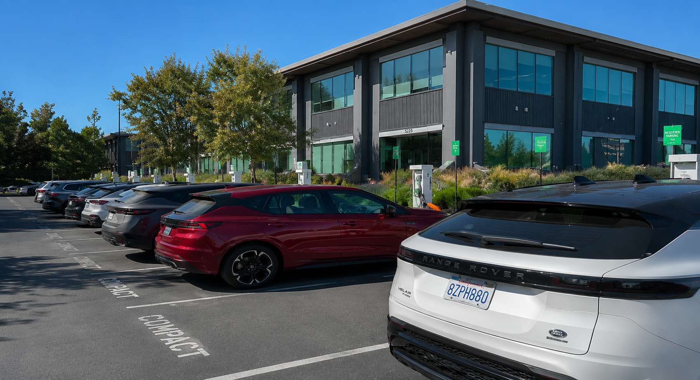
Workplace EV Charging Provides an Opportunity
Operator
Heterogeneous chargers: some charge only, bidirectional chargers can also discharge EVs back to the building.
At plug-in, user states charge (SoC) needed and planned departure time.
At each step, charging controller π^{ch} sets continuous (dis)charging rate per EV, under user, charger, battery, and building constraints.
Demand charge = highest power draw in billing period. One peak hits the monthly bill, making this a long-horizon problem
Decisions made without exact knowledge of future users (arrivals, departures, charge requests, or building load)
Nissan Advanced Technology Center– Silicon Valley (NATC-SV), Santa Clara
2
Notes:
60s
• The V2B setting is a commercial operator with a building connected to the grid, with multiple heterogeneous chargers, both unidirectional or bidirectional - meaning it can charge and discharge EVs to power the building.
Please note that the building does not sell power back to the grid.
• On plug-in, the user declares a required state of charge (SoC) and a departure time.
• The controller sets charging rates at fixed intervals under user, charger, and building constraints.
[click]
• The bottom figure shows a building’s typical load profile, with mid-day peaks (shown in red)
But a smart coordinated controller can cut the peak, and even reduce it below the no-EV baseline (as shown in green). This reduces a large part (around 30-40%) of the operator's bill by reducing the demand charge. Demand charge is imposed on peak power use, calculated over a month.
• Most importantly, for an online controller, all of this happens without exactly knowing future arrivals or future building loads.

Slide 3
Adding human in the loop: EV user flexibility
Prior V2B work, including ours, optimized charging under uncertainty but treated user needs as fixed inputs.
Simulation → Online Control → Learning
2024
2025
2025
SMARTCOMP
ICCPS
AAMAS★
OPTIMUS¹
DG-MCTS²
RL-V2B³
Discrete V2B Simulation
+ Heuristic solvers
Online, robust
Decision-making without training
Fast, online, constrained decisions under sparse rewards
HYPOTHESIS FOR THIS PAPER
In workplace charging, employee flexibility on departure time and requested state of charge (SoC) can be
negotiated via incentives, improving both building cost and user outcomes.
★ = Nominated for Best Paper Award
[1] Talusan et. al., Optimus: Discrete event simulator for vehicle-to-building charging optimization, SMARTCOMP 2025
[2] Sen et. al., Online Decision-Making Under Uncertainty for Vehicle-to-Building Systems, ICCPS 2025
[3] Liu et.al., Reinforcement Learning-based Approach for Vehicle-to-Building Charging with Heterogeneous Agents and Long Term Rewards, AAMAS 2025
Notes:
30s
Prior V2B work, including our own, optimized charging under uncertainty.
The arrow traces our progression: from simulation to online control at ICCPS, and learning based approach at AAMAS last year.
But all three treated user requirements as fixed inputs.
Our hypothesis for this paper is that workplace employees who usually stay longer, have real flexibility on range (that is, SoC) requirements and departure times, and we can unlock it with proper incentives.

Slide 4

Adding human in the loop: EV user flexibility
Select & charge
² Runs policy
¹ Provides request
YOUR REQUEST
80% SoC by 4:00 PM
$$$
SUGGESTED
70% SoC by 4:00 PM
$$
80% SoC by 4:30 PM
$$
60% SoC by 5:30 PM
$
⁴ Picks an option
REJECT ALL
³ Posts options
Nissan Advanced Technology Center– Silicon Valley (NATC-SV), Santa Clara
SELECT & CHARGE
Key Contributions:
A menu-based mechanism with strategy-proofness (on departure time & SoC), budget feasibility, and promotes voluntary participation.
A stochastic Model Predictive Control (MPC) operator policy computing the menu via Monte-Carlo sampling (MC-MPC).
Empirical validation on Nissan operational data, with a user model calibrated from an n = 28 stated-preference survey.
Notes:
60s
The diagram here sets up the problem.
In Step 1, a user arrives and submits a required SoC and departure time.
Then in Step 2, the inputs are provided to a negotiation policy.
In step 3, the policy generates a menu of flexible options and, also include the user’s request. The additional flexible options ask for deviation in SoC or departure time in return for a lower charging cost.
Crucially, there is always a reject-all option in the menu, allowing users to refuse all the choices provided and walk away.
In Step 4, the user selects an option, and an underlying charging policy sets the charging rates until departure.
[click]
For this paper, Three key contributions follow.
First, a menu-based mechanism that's strategy-proof, budget-feasible, and promotes voluntary participation.
Second, a stochastic, online Model Predictive Control (or MPC) policy that computes the menu via Monte Carlo sampling.
And third, empirical validation on real Nissan data, with a user model from a stated-preference survey.

Slide 5
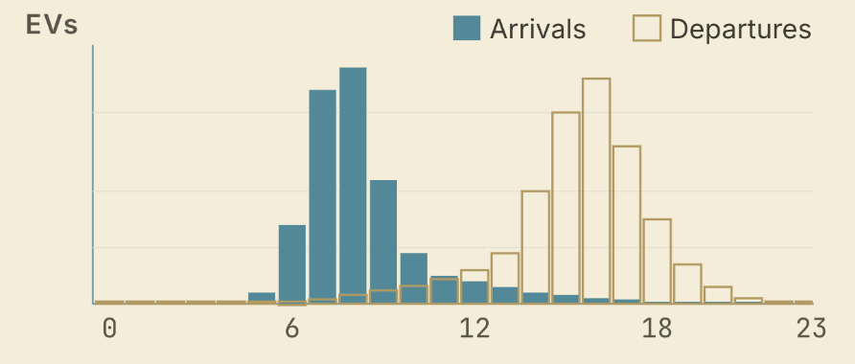
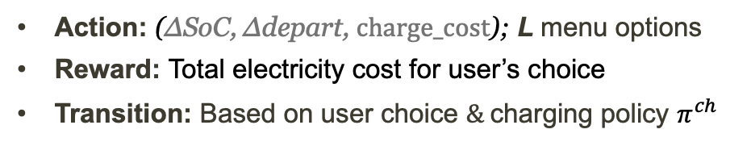
Modeling: Options Menu using a Semi-Markov Decision Process (SMDP).
We choose an SMDP, because the problem evolves in continuous-time but the sojourn time distribution is not memoryless: in our data, EV arrivals are sparse and bunched.
Our mechanism is strategy proof (shown later).
Here, we address the Stochastic Planning Problem for the operator.
SMDP STRUCTURE (Triggered at EV arrival)
  States:
  Time; building load (current + historical)
  For arrived, current EVs:
    SoC requirements, expected departures
Action: (ΔSoC, Δdepart, $\text{charge}\text{_}\text{cost}$); L menu options
Reward: Total electricity cost for user’s choice
Transition: Based on user choice $\&$charging policy $π^{ch}$
Event-driven (per arrival)
→
Time-driven (every 15 minutes)
Negotiation policy π^{neg}
Charging policy π^{ch}
(details in paper)
Notes:
80s
We model this problem as a Semi-Markov Decision Process (or SMDP), where, time is continuous, but our target events which are the EV arrivals, are sparse and clustered, and the sojourn times are not memoryless.
And since our mechanism is strategy-proof, we only address the operator's stochastic planning problem.
The state captures the building load (both past and present), the choices of connected EVs, and the arriving user's request. The action is the menu of negotiation options offered to that user.
The reward is the operator's electricity bill under the user's marginal utility, and transitions follow user choice and charging actions.
Now, the bottom panel shows a coupling between two policies: the negotiation policy fires at each arrival, and sets the user choice
While the charging policy runs at each time step to smartly charge the EVs and meet the negotiated SoC by departure. It uses another online MPC solution and is detailed in the paper.
For brevity of time, I will focus on the negotiation policy and details of the mechanism design.

Slide 6
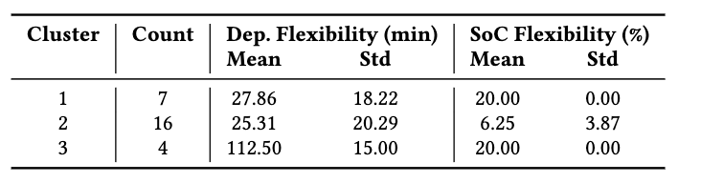



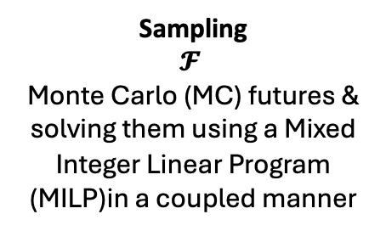

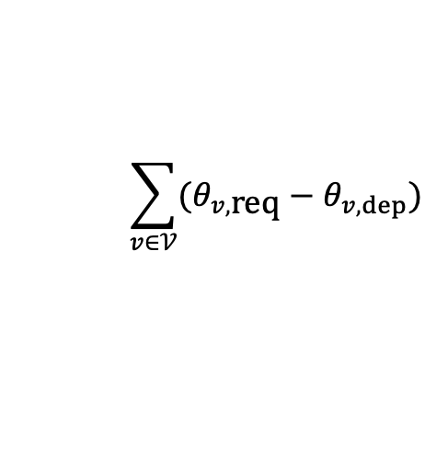

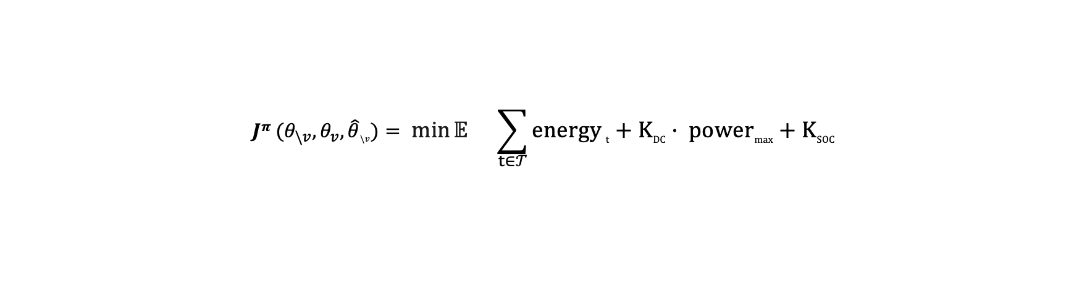


Approach: Generating Menu using MC-MPC for user $v$ $(π^{\text{neg}})$
Other arrived users
Expected future users
Energy cost
Demand charge
Missing departure SoC penalty
$$\sum_{v∈𝒱}{(θ_{v,\text{req}}−θ_{v,dep}\text{)}}$$
$$Jπ (θ_{\backslash v}, θ_{v},\hat{θ}\backslash v)= \min{𝔼_{}} \sum_{t∈𝒯}{energy}t +KDC · powermax +KSOC$$
Operator cost with choice$θ_{v}$:
Solves a combined MILP
System State $S_{t}$
(load $P$, SoC $e$, arrivals, pricing $W$)
Choice $θ_{v}$
$(ΔSoC, Δdepart)$
From L+1 options
Model Predictive Control
(MC-MPC)
Maintains Physical & User constraints under Uncertainty
Goal: Decide charging rates to minimize electricity cost
Action $A_{t}$
(ΔSoC, Δdepart, $\text{charge}\text{_}\text{cost}$)
User’s Charging cost for choice $θ$
From stated-preference user survey
Past EV arrivals
$𝓕$Future chains
Sampling
$$𝓕$$
Monte Carlo (MC) futures & solving them using a Mixed Integer Linear Program (MILP)in a coupled manner
$$s$$
Best action $A$
for current state $s$
Captures future uncertainty
(Sampled users never deviate)
timeline
Notes:
120s
Let's look at how we solve this online.
At each arrival, we have the current state.
[click]
Next, we offer L flexibility levels to the user, plus their exact request, giving us L+1 candidate options, denoted by θ, which capture the deviations in required SoC and departure time for that option.
For our experiments, we used the survey, asking users about their delays and compensations, as noted in the table below. That's where we got the different θ s from.
[click]
Next, we use stochastic MPC with Monte Carlo sampling to decide the cost of a choice θ.
An MPC is used as it explicitly enforces hard constraints like charger limits and SoC bounds.
The objective is to minimize the expected total cost — across choices of arrived users, the current user, and expected future choices, and the minimization is over energy cost, demand charge, and strict penalties on not charging the EV to its promised departure SoC.
[click]
First, we draw future trajectories from our generative model: arrivals, their SoC requests, and building load. We assume future users don't deviate from their initial choice, giving us a worst case bound.
Then we solve a Mi MILP coupled only at the current state, that minimizes the expected cost across the samples.
[click]
The action we get for each choice is a tuple of SoC deviation, departure deviation, and charge cost.

Slide 7
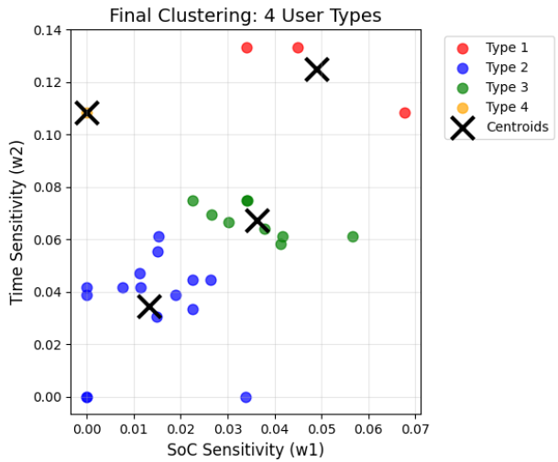

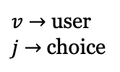
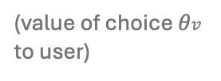

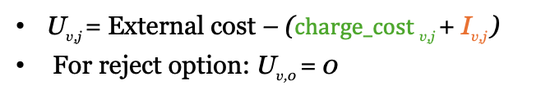



Stated-preference survey $→$ User Choice modeling
Select & charge
$$θ_{v}^{1}$$
YOUR REQUEST
80% SoC by 4:00 PM
$$$
We model each user as a discrete-choice agent, picking among options (or rejecting) via a softmax on utility.
$$θ_{v}^{2}$$
SUGGESTED
70% SoC by 4:00 PM
$$
$$θ_{v}^{3}$$
80% SoC by 4:30 PM
$$
Choice probability: Logit
$$θ_{v}^{4}$$
60% SoC by 5:30 PM
$
exp (U_{v,j})
;
$v$ $→$ user
$j$ $→$choice
REJECT ALL
P
(
j
|
v
) =
Σ_{k ∈ Mv ∪ {0}} exp (U_{v,k})
SELECT & CHARGE
User’s Utility
U_{v,j} = External cost – ($\text{charge}\text{_}\text{cost}$_{v,j} + I_{v,j} )
For reject option: U_{v,0} = 0
(value of choice $θv$ to user)
User's charge cost
Current choice
charge_cost_{v,j} = $Energy cost\text{v}\text{,}\text{j}$− $α$ · $𝔼 [ Jπ∗\left(θ\backslash v,\hat{θ}\backslash v\right)− Jπ∗\left(θ\backslash v,θ_{v}^{j},\hat{θ}\backslash v\right)]$
From stated-preference user survey
Marginal Utility of choice $θv$ to operator
Inconvenience
SoC sens.
Time sens.
I_{v,j} = w₁ ΔSoC_{v,j} + w₂ Δdepart_{v,j}
Notes:
90s
Now, coming to the user-facing side.
Let me quickly remind you of the menu we offer, where the options trades-off deviations in requested SoC and departure time for a cheaper cost, and a reject-all option.
[click]
Each user is a discrete-choice agent, with softmax probability over utility U.
[click]
The utility for an option equals the external charging price — say, at the nearest charger — minus the option's charge cost (in green) and the user's inconvenience (in red). Let me explain each.
[click]
In green, the charge cost is energy paid at the time-of-use rate, after deducting an incentive based on the marginal utility of the user, which depends on how much the user helps reduce the building’s peak load.
[click]
And in red, the inconvenience metric is a linear combination of sensitivity to requested SoC and departure-time deviations, with weights calibrated from the survey on the right.
For the experiments, we cluster the respondents into four heterogeneous user types.
The overall intuition of having this choice model is that real users aren't uniformly flexible, and each user compares against an external option to maximize their benefit.

Slide 8
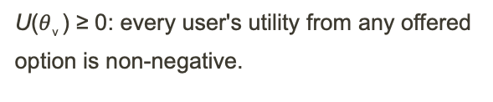
Mechanism guarantees
Strategy-proofness (SP)
Budget feasibility
Voluntary participation
Truthfully reporting SoC and departure time maximizes a user's utility.
Incentive offered ≤ system savings produced by that user's choice.
U($θ$_{v} ) ≥ 0: every user's utility from any offered option is non-negative.
The proofs can be found in the paper.
WE DO NOT CLAIM
Strategy Proofness in repeated play: single-shot only.
Collusion-proofness: assumes no user coordination.
Notes:
40s
The framework gives us three formal guarantees.
First, strategy-proofness — our system guarantees monotonically decreasing prices as the user's feasibility space grows, which allows more peak reduction.
Second, budget-feasibility — the offered costs stay within expected savings for the building, under the worst-case behavior from future users.
And third, voluntary participation — no user is ever worse off. The user choice model guarantees this by comparing to an external cost.
Full proofs are in the paper.
A couple of caveats: we don't claim repeated-game strategy-proofness across days, and we assume no coordination between users, so no collusion.

Slide 9
Experimental setup
SITE, DATA, INFRASTRUCTURE
Site: NATC-SV, Santa Clara, CA
Data window: May 2023 – Nov 2024 (22 months)
Episodes: 100 (70 sampling / 30 testing) per month
Chargers: 10 unidirectional (0–20 kW) + 5 bidirectional (±20 kW)
TARIFF (Silicon Valley Power commercial)
Peak (6 AM–10 PM) | $0.178 / kWh
Off-peak | $0.137 / kWh
External rate (for user choice model) | $0.30 / kWh
Demand charge | $11.67 / kW
Nissan Advanced Technology Center– Silicon Valley (NATC-SV), Santa Clara
Notes:
30s
We validate on real data from Nissan. -- 30 test samples over 22 months of building load, charger activity, and EV user telemetry.
Fifteen chargers: ten unidirectional and five bidirectional, all rated at twenty kilowatts.
Tariffs follow the local utility's commercial rates — Silicon Valley Power — with about $12 per kW demand charge, so every kW shaved from the monthly peak saves about $12. External charging rate is set at a modest 30 cents per kWh, which is on the cheaper end for public rates, and even comparable to some home rates.

Slide 10

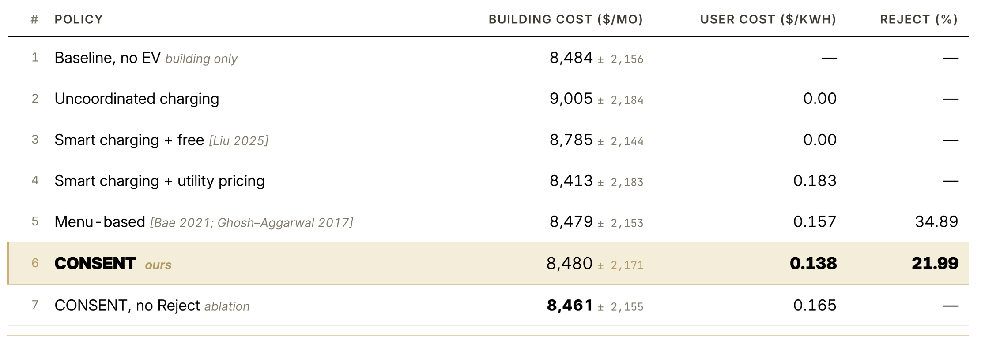
Results: Comparing against Baselines
Hypothesis is validated: Negotiating departure times and SoC demand with users $→$ operator & user cost reduction
CONSENT delivers a balance between building savings and the user savings.
Notes:
60s
And the results validate our hypothesis from earlier.
By leveraging user flexibility, and doing calibrated negotiation we can deliver both lower building cost and lower user cost than non-negotiating baselines.
Against state of the art menu-based approaches, CONSENT reduces the rejection of simulated users by 13%, so more of them opt to use the system, and user cost drops by 12%.
Against free smart-charging, CONSENT also reduces the operator cost by 3.5% — so the building also saves.
The takeaway here is that CONSENT strikes a good balance across all three metrics, the building’s electricity cost, the user’s charging cost and the rejection rates, beating non-negotiating baselines on cost while retaining good participation.

Slide 11
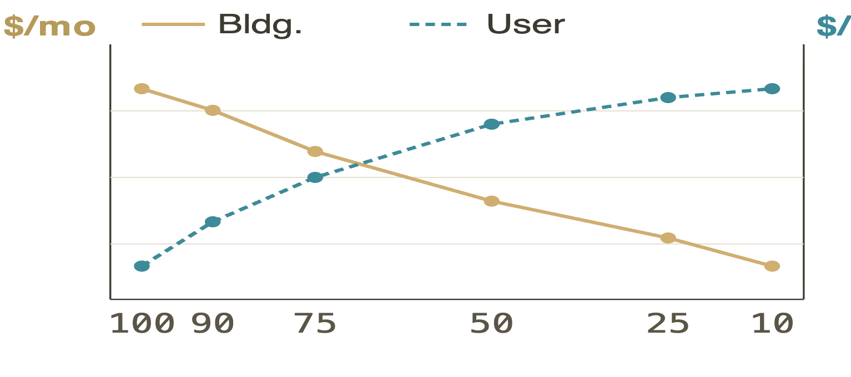
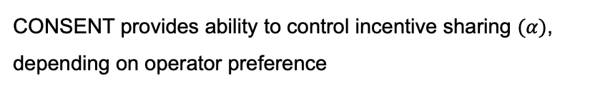


Sensitivity: Robustness across cost-sharing and user flexibility
ROBUSTNESS to USER FLEXIBILITY · CONSENT VS. MENU-BASED (REJECT %)
$α$-SWEEP · INCENTIVE SHARING CONTROL (PARETO FRONTIER)
kWh
POPULATION
CONSENT (%)
MENU-BASED (%)
8500
0.18
1. Baseline (survey)
21.99
34.89
2. Less flexible (+25 % sensitivity)
22.65
36.46
3. More flexible (−25 % sensitivity)
19.33
33.50
0.14
4. Range(SoC)-sensitive (+50 % w₁)
23.09
36.63
8400
5. Time-sensitive (+50 % w₂)
22.87
36.81
$α−$sweep
CONSENT's rejection-rate advantage (≈ 12%–14% lower) holds.
CONSENT provides ability to control incentive sharing $(α)$, depending on operator preference
Detailed analysis in full paper
Notes:
30s
We also did sensitivity analysis, ablation testing and more analysis including the charging policy. You can find them in the paper.
We also did sensitivity analysis, on cost-sharing ratios and user flexibility profiles. More details and other analysis are in the paper.
On the left, we see that changing the incentive sharing ratio (alpha) tunes the trade-off: less building savings & lower user cost on the left to more building savings at higher user cost on the right.
There is a sweet opt somewhere in between, and operators can set their own sharing ratio.
On the right, the table shows what happens when we have more variations in user types, beyond our survey.
Across less flexible, more flexible, time-sensitive, and range (or SoC)-sensitive populations, CONSENT's rejection advantage holds at twelve to fourteen percentage lower than existing menu-based approaches.

Slide 12
Conclusion & Future Scope
01
02
03
Negotiating on flexibility works.
Fast, online solution.
Genuinely win-win.
Lower rejection compared to existing menu-based systems. Having an option to reject helps.
~0.8 s per user menu; fits inside a 15-minute control loop in a real building.
Operator, user, grid; all strictly better off, with formal guarantees.
FUTURE WORK
Capture and integrate recurring, persistent users over long horizons to unlock greater EV battery flexibility.
Repeated-game guarantees; extend strategy-proofness from single-shot to long-horizon negotiation.
Multi-building / aggregator-scale negotiation for demand response participation.
Notes:
50s
Moving to the Conclusion, there are three main takeaways.
First, We built an operator-based negotiation system that boosts participation compared to existing menu-based systems while providing a reject option to build user trust.
Second, the online solution is fast, taking under a second to generate menus for a 15 charger V2B setting.
Third, the outcome is genuinely win-win across operator, user, and a not so explicit part – the power grid, all with formal guarantees.
Future work is to capture persistent or recurring user behavior to unlock more long term flexibility.
Second is to extend strategy-proofness from one-shot to repeated-game settings.
And, expand the scale by including multiple buildings, to provide aggregator level strategies.

Slide 13

Thank you.
Select & charge
² Runs policy
¹ Provides request
YOUR REQUEST
80% SoC by 4:00 PM
$$$
SUGGESTED
70% SoC by 4:00 PM
$$
80% SoC by 4:30 PM
$$
60% SoC by 5:30 PM
$
⁴ Picks an option
REJECT ALL
³ Posts options
SELECT & CHARGE
FULL PAPER · arXiv
rishav.sen@vanderbilt.edu
CONTACT
Thanks to our collaborators at Nissan Advanced Technology Center — Silicon Valley . Work supported in part by the National Science Foundation .
Notes:
10s
Thank you for attending my talk. I would be happy to take any questions now, and please feel free to follow up with me by email.
You can also access the paper through the QR code.
Thank you!

Slide 14




1
3
USER EXPERIENCE
Select & charge
Users are provided choices
YOUR REQUEST
80% SoC by 4:00 PM
$$$
Users arrive at work on their EVs
SUGGESTED
1.
Arrival. User submits required SoC and departure time.
70% SoC by 4:00 PM
$$
2
80% SoC by 4:30 PM
$$
Cloud
2.
Menu. System returns a personalized option set with prices.
60% SoC by 5:30 PM
$
3.
Choice. User picks one option, or rejects all and plugs in at standard rate.
They enter:
Departure time
Requested SoC
REJECT ALL
SELECT & CHARGE
4.
Charging. The controller schedules kW to hit the chosen target by the chosen departure.
5
4
More flexibility → more discount. Reject all is always an option.
Chargers charge/discharge EVs to meet desired charge
Connect their EV to a charger, expecting desired charge level by departure
Notes:
This is what the user actually experiences. They pull into the lot, open the app, and enter two things: how charged they need their car to be, and when they're leaving. The system comes back with a small personalized menu. The top option is exactly what they asked for, at standard price. The other options trade a little flexibility — maybe ten percent less charge, or thirty minutes later — for a real discount. They pick whichever one they want, or they reject all and just plug in normally. That's it. The whole negotiation is one tap.
say-> how this sytem typically works -> user submits request -> accept/reject -> what layer have I added on top?

Slide 15
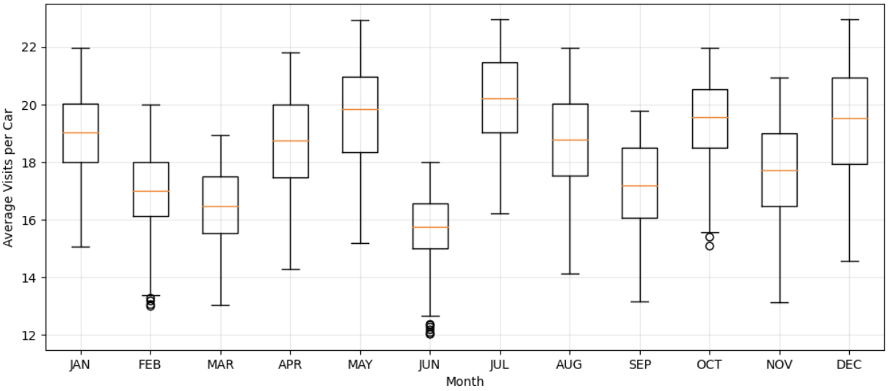
19 / 26
THE EVIDENCE
The same people arrive every day.
Anonymized commuter data from Nissan's Santa Clara office. A sharp morning arrival peak, and a median of 15 visits per vehicle, every month.
Arrival time distribution
Monthly visit frequency per vehicle
discrete · binned by hour · all vehicles · 2024
discrete · one point per month · median & mean · 2024
Notes:
But in a real office building, the same fifteen or twenty employees show up every single day. Look at the arrival-time histogram — there's a sharp morning peak. The average car visits fifteen to twenty times per month. These aren't strangers; they're regulars. That persistence means the SoC you leave a car at on Tuesday evening is the SoC that car arrives with on Wednesday morning — minus whatever they used driving home.

Slide 16
20 / 26
EVALUATION
A full year of real building load from Nissan Santa Clara.
Monthly building load profile, 2024
kW · 15-min resolution
15
Persistent users · Bidirectional chargers · 20 kW max
$0.18 / kWh
Peak time-of-use · 6 AM – 10 PM
$11.67 / kW
Demand charge during peak hours (6AM -10PM)
30 x 22 test samples
Stochastic monthly scenarios
Notes:
To close: persistence is a structural feature of real office EV fleets, and ignoring it costs money. A neuro-symbolic controller — short-horizon MILP with a learned long-horizon terminal cost — gets you near-oracle performance while respecting every user's charging requirement, and it scales to larger fleets within the fifteen-minute control window. I'd love to take your questions.

Slide 17
ABLATION
What does the reject-all option buy us?
Compare CONSENT with and without the reject-all option in the menu.
Removing reject…
Forces 100% participation by construction.
VARIANT
BUILDING ↓
USER SAVINGS ↓
PARTICIPATION
Cuts user savings from 22.5% to 7.3%.
CONSENT (reject ✓)
5.87
22.5
78.0
Breaks the voluntary participation guarantee.
CONSENT (reject ✗)
6.05
7.3
100
Notes:
One ablation worth calling out. Removing the reject-all option lifts participation from seventy-eight to one hundred percent — every user is forced in — and you get a slightly higher user-satisfaction average in raw numbers. But it kills voluntary participation as a guarantee, and in real deployment that's the thing operators tell us they actually need. The right design choice for a real building is to keep the reject option in, accept a participation rate in the high seventies, and earn user trust over time.

Slide 18
BACKUP · B3
Negotiation Policy: Full flexibility sensitivity (Table 2)
POPULATION
CONSENT BLDG ($/MO)
CONSENT USER ($/KWH)
CONSENT REJECT %
NO-REJECT BLDG ($/MO)
NO-REJECT USER ($/KWH)
MENU-BASED BLDG ($/MO)
MENU-BASED REJECT %
More flexible (−25 %)
8 471 ± 2 168
0.131 ± 0.02
19.33
8 449 ± 2 152
0.158 ± 0.02
8 462 ± 2 149
33.50
Range-sensitive (+50 % w₁)
8 488 ± 2 178
0.143 ± 0.03
23.09
8 466 ± 2 161
0.170 ± 0.02
8 484 ± 2 158
36.63
Time-sensitive (+50 % w₂)
8 485 ± 2 175
0.141 ± 0.03
22.87
8 464 ± 2 158
0.168 ± 0.02
8 481 ± 2 156
36.81
Baseline (survey)
8 480 ± 2 171
0.138 ± 0.03
21.99
8 461 ± 2 155
0.165 ± 0.02
8 479 ± 2 153
34.89
Less flexible (+25 %)
8 491 ± 2 179
0.144 ± 0.03
22.65
8 469 ± 2 162
0.172 ± 0.02
8 486 ± 2 160
36.46
All policies × five flexibility profiles, mean ± std across held-out episodes. CONSENT building cost is statistically indistinguishable from menu-based across every row; rejection rate is uniformly 12–14 pp lower; user cost is uniformly lower than no-Reject. Use to defend "what if our survey is wrong?"
Notes:
Backup — full flexibility sensitivity table.

Slide 19
BACKUP · B4
Charging policy: MC-MPC vs. charging-only baselines (Table 10)
POLICY
EIGHT-MONTH BLDG COST ($/MO, MEAN ± STD)
GAP TO ORACLE
Oracle (MILP, perfect foresight)
8 312 ± 2 088
—
MC-MPC (ours)
8 444 ± 2 144
+ 1.6 %
RL
8 521 ± 2 197
+ 2.5 %
LLF (least laxity first)
8 698 ± 2 234
+ 4.6 %
EDF (earliest deadline first)
8 714 ± 2 241
+ 4.8 %
ReqCharge
8 762 ± 2 256
+ 5.4 %
MaxCharge
9 005 ± 2 184
+ 8.3 %
Headline: MC-MPC stays within 1.6 % of oracle over eight months and beats RL on average. Use to defend "why MPC is necessary."
Notes:
Backup — MC-MPC vs charging-only baselines, eight-month head-to-head.

Slide 20
BACKUP · B5
Charging policy: Uncertainty stress tests (Tables 12–13)
STRESS SCENARIO
ORACLE ($/MO)
MC-MPC ($/MO)
GAP
Departure-time noise (Gaussian σ = 2 h)
8 358 ± 2 102
8 521 ± 2 168
+ 1.9 %
OOD SoC (± 15 %)
8 401 ± 2 124
8 593 ± 2 195
+ 2.3 %
Building-load noise (± 15 %)
8 389 ± 2 117
8 553 ± 2 183
+ 2.0 %
Mid-day price spike (+ 20 %)
8 612 ± 2 196
8 854 ± 2 271
+ 2.8 %
Fleet scale-up (× 2)
12 845 ± 3 217
13 196 ± 3 305
+ 2.7 %
MC-MPC stays within 2–3 % of oracle across all five stress scenarios. The Sample Average Approximation absorbs distributional shift without re-tuning.
Notes:
Backup — uncertainty stress tests across five scenarios.

Slide 21
BACKUP · B6
Generative-model diagnostics (Table 9)
COMPONENT
FAMILY
GOODNESS-OF-FIT
NOTES
Arrival count per 15-min bin
Zero-inflated negative binomial
pseudo-R² = 0.34
Captures sparsity + bursts.
Arrival SoC
Beta
KS p = 0.41
Bounded [0, 1]; right-skew at site.
Departure SoC (conditional)
Beta, conditioned on arrival SoC
KS p = 0.38
Conditional on arrival reduces variance.
Stay duration
Weibull
C-index = 0.71
Captures shift-end mass + long-stay tail.
All four components are fit independently on the training partition; samples are drawn jointly at MC-MPC time. The ZINB is the only piece flagged for non-stationarity (slide 12).
Notes:
Backup — ZINB diagnostics and goodness-of-fit for the generative components.

Slide 22
BACKUP · B8
Computational cost & scaling (Fig. 2)
PER-STEP WALL-CLOCK (32-CORE, 6.2 GHZ)
SCALING — CARS PER DAY
OPERATION
MEDIAN (S)
CARS / DAY
MENU GEN (S)
STEP OPT (S)
Per-arrival menu generation
0.80
6
0.42
0.31
Per-timestep charging optimization
0.99
12
0.61
0.54
Single counterfactual MILP
0.41
30
0.80
0.99
One future sample (|𝓕| = 10)
0.06
60
1.42
1.71
Roughly linear in number of EVs; MILP work scales as |𝓕| × L scenarios per arrival. Comfortably real-time at the operational fleet size of this site.
Notes:
Backup — computational cost and scaling.

